Slide 1
AS/A Level
Further Mathematics

Slide 2
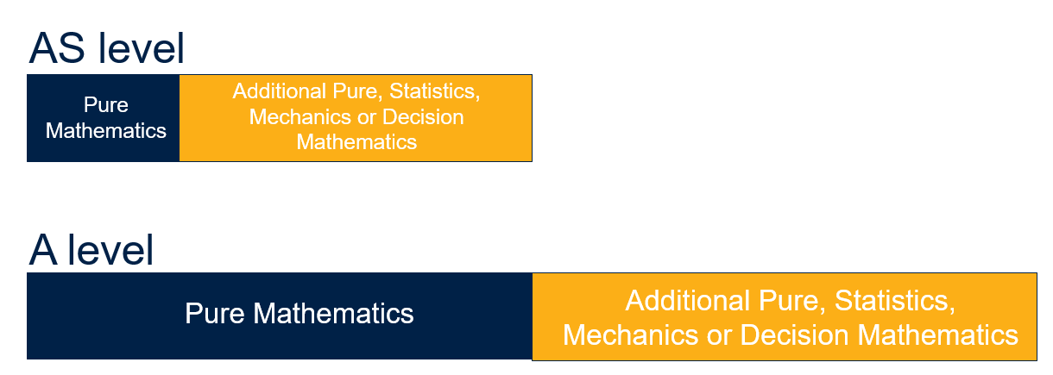
AS/A level Further Mathematics course structure
Further Mathematics is taken in addition to A level Mathematics
Pure mathematics content makes up 50% of the AS level and 50% of the A level.

Slide 3
FPSS entry requirements
AS/A level Further Mathematics
At least grade 7 in GCSE Maths.

Slide 4
Taster lessons
Lesson 1 – Series (Core Pure 1)
Lesson 2 – Complex Numbers (Core Pure 1)

Slide 5
Series
Lesson 1

Slide 6
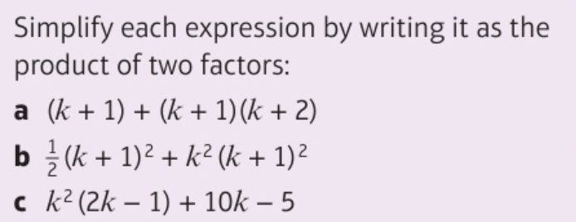
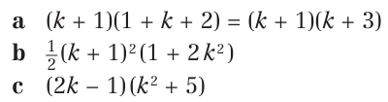
DO NOW:

Slide 7
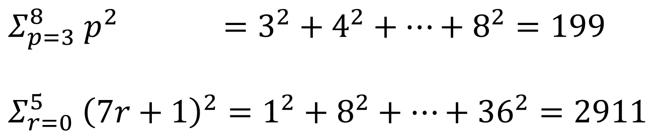
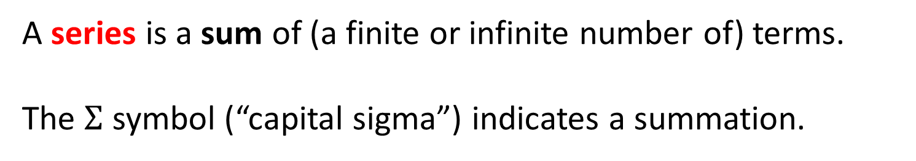
Sigma notation
A series is a sum of (a finite or infinite number of) terms.
The $Σ$ symbol (“capital sigma”) indicates a summation.
Determine the following results by explicitly writing out the elements in the sum:
?
$$Σ_{p=3}^{8} p^{2} =3^{2}+4^{2}+…+8^{2}=199$$
$$Σ_{r=0}^{5} {\left(7r+1\right)}^{2}=1^{2}+8^{2}+…+{36}^{2}=2911$$
?

Slide 8

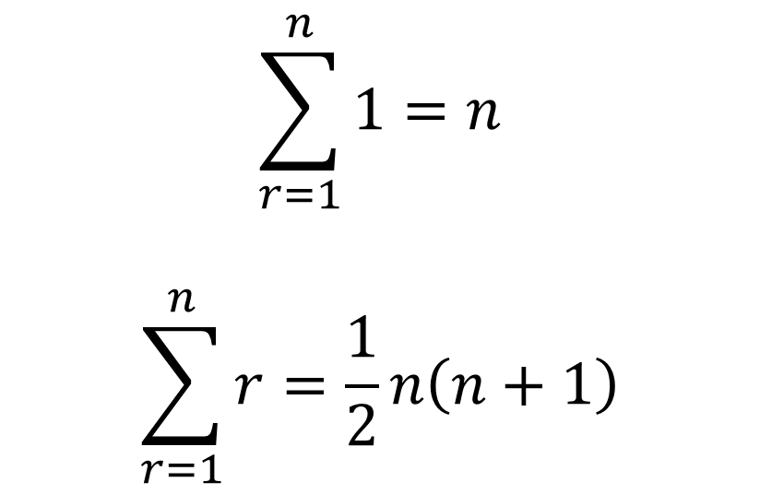
Sum of 1s and natural numbers
$$\sum_{r=1}^{n}{1=n}$$
$$\sum_{r=1}^{n}{r=\frac{1}{2}n\left(n+1\right)}$$
?
?
Sum of first $n natural numbers$

Slide 9
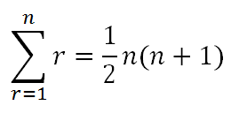
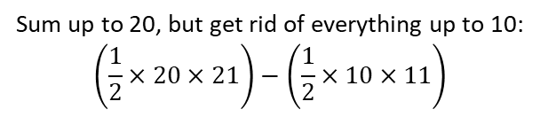
Quick fire: triangulars!
1 + 2 + 3 + ... + 10 = 55
1 + 2 + 3 + ... + 99 = 4950
11 + 12 + 13 + ... + 20 = 210 – 55 = 155
100 + 101 + 102 + ... + 200 = 20100 – 4950 = 15150
?
?
Sum up to 20, but get rid of everything up to 10:
$$\left(\frac{1}{2}×20×21\right)−\left(\frac{1}{2}×10×11\right)$$
?
?

Slide 10
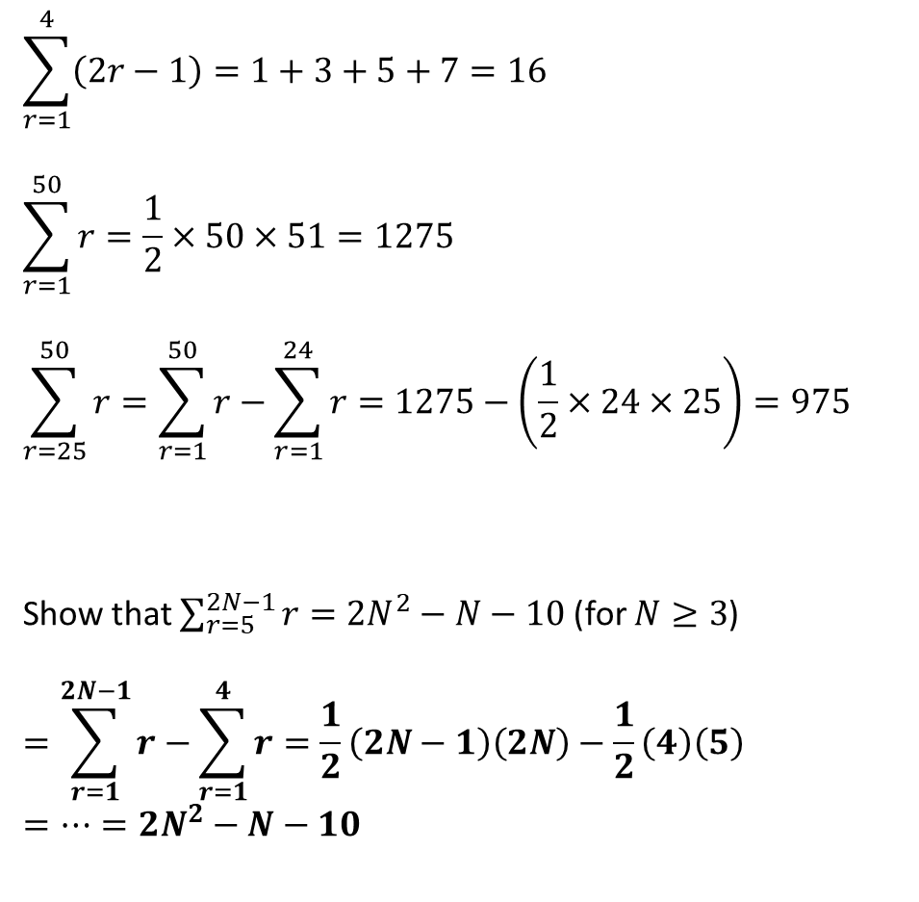
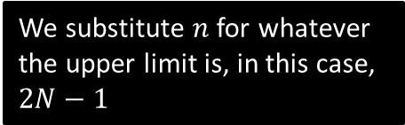
Evaluate…
$$\sum_{r=1}^{4}{\left(2r−1\right)}=1+3+5+7=16$$
$$\sum_{r=1}^{50}{r}=\frac{1}{2}×50×51=1275$$
$$\sum_{r=25}^{50}{r}=\sum_{r=1}^{50}{r}−\sum_{r=1}^{24}{r}=1275−\left(\frac{1}{2}×24×25\right)=975$$
Show that $\sum_{r=5}^{2N−1}{r}=2N^{2}−N−10$ (for $N≥3$)
$$=\sum_{r=1}^{2N−1}{r}−\sum_{r=1}^{4}{r}=\frac{1}{2}\left(2N−1\right)\left(2N\right)−\frac{1}{2}\left(4\right)\left(5\right) \\ =…=2N^{2}−N−10$$
?
There are sufficiently few terms that we can just list them.
?
?
Tip: For summations where you subtract, ensure that you use one less than the lower limit.
?
We substitute $n$ for whatever the upper limit is, in this case, $2N−1$

Slide 11
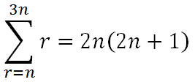
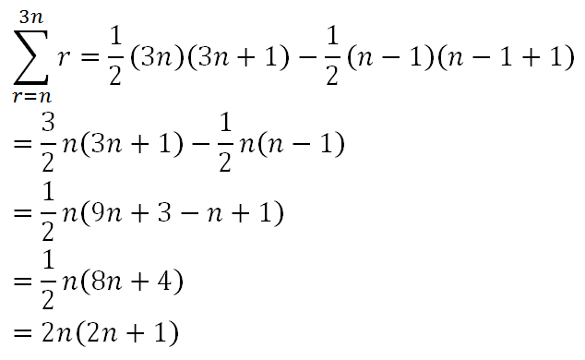
Test your understanding…
Tip: After writing out your initial subtraction, DO NOT expand out – is there a common term you can factorise?
Show that
?
?

Slide 12
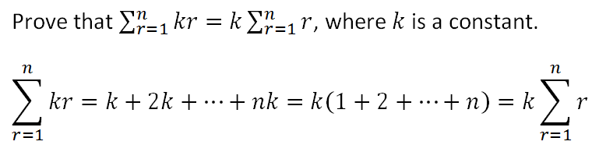
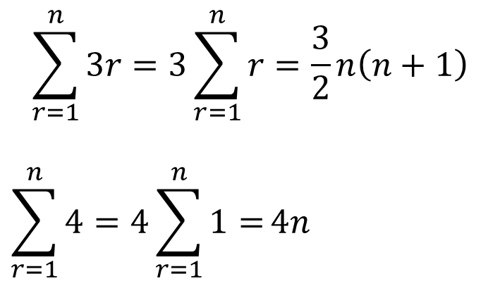
Breaking up summations
?
Examples:
$$\sum_{r=1}^{n}{3r}=3\sum_{r=1}^{n}{r}=\frac{3}{2}n\left(n+1\right)$$
$$\sum_{r=1}^{n}{4}=4\sum_{r=1}^{n}{1=}4n$$
?
?
?
?

Slide 13
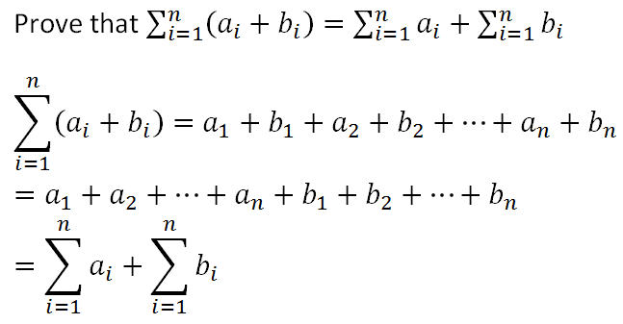
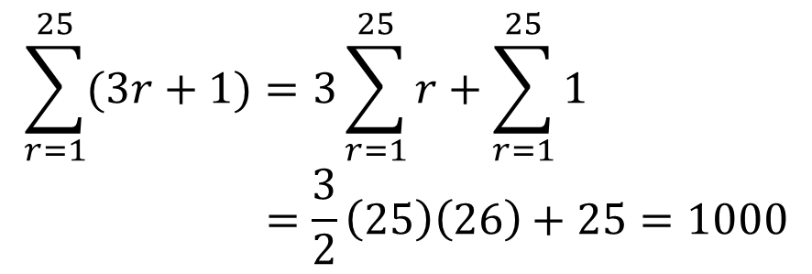
Breaking up summations
?
?
?
$$\sum_{r=1}^{25}{(3r+1)}=3\sum_{r=1}^{25}{r}+\sum_{r=1}^{25}{1} \\ =\frac{3}{2}\left(25\right)\left(26\right)+25=1000$$
?
We can combine this property of summations with the previous one to break summations up:
?

Slide 14
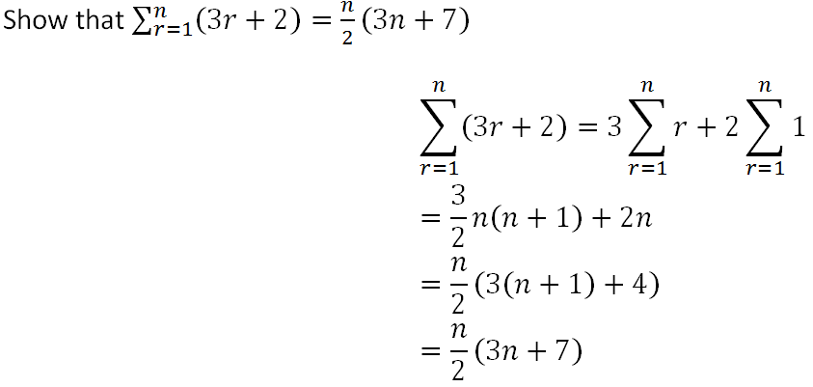
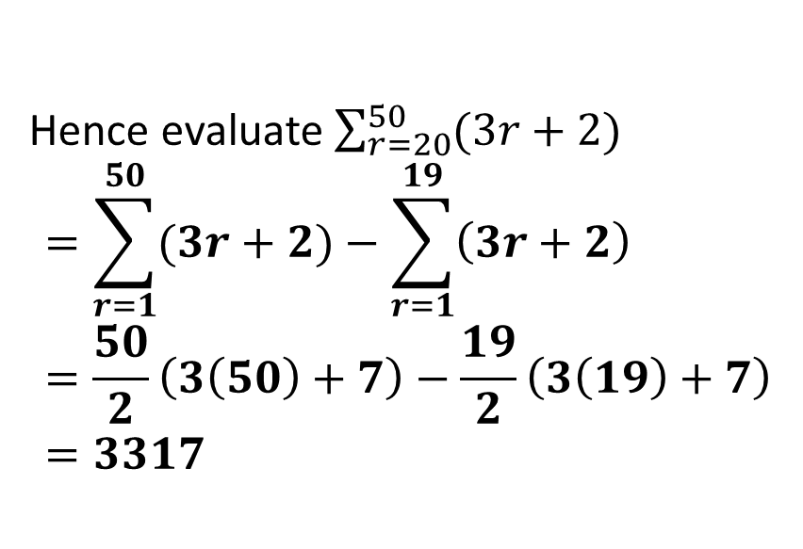
Test your understanding
?
Hence evaluate $\sum_{r=20}^{50}{(3r+2)}$
$$=\sum_{r=1}^{50}{(3r+2)}−\sum_{r=1}^{19}{\left(3r+2\right)} \\ =\frac{50}{2}\left(3\left(50\right)+7\right)−\frac{19}{2}\left(3\left(19\right)+7\right) \\ =3317$$
?

Slide 15
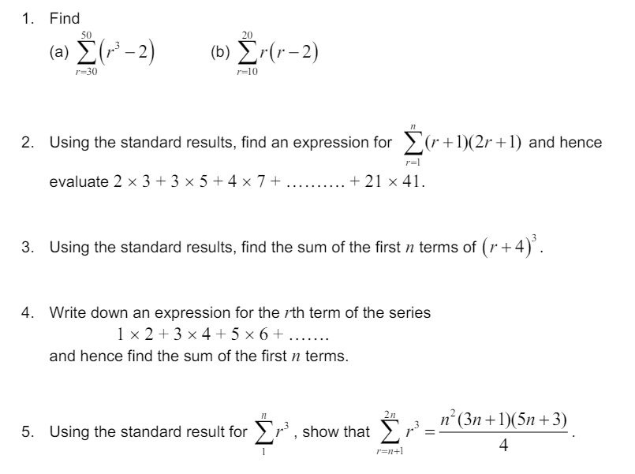
Your turn…

Slide 16
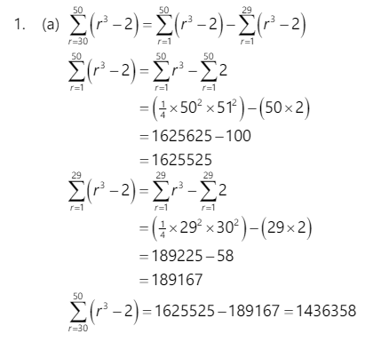
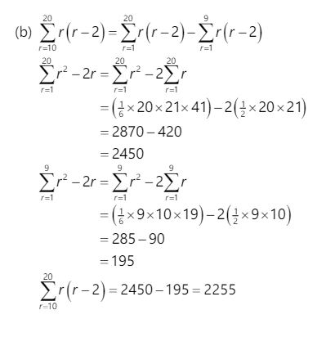
Answers

Slide 17
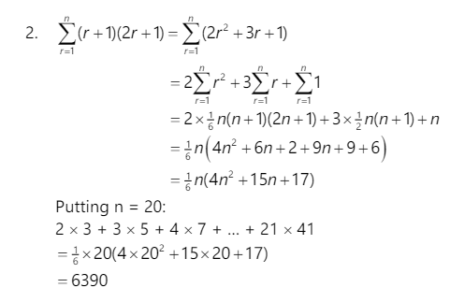
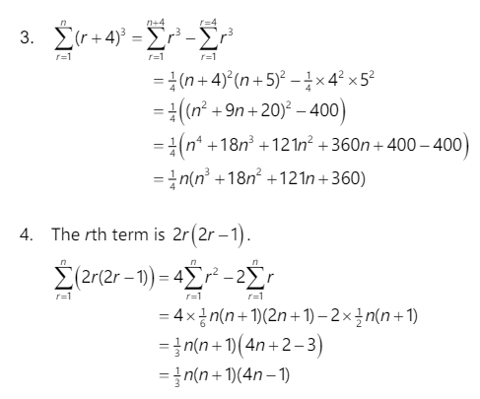
Answers

Slide 18
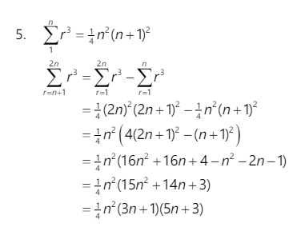
Answers

Slide 19
Any questions?

Slide 20
COMPLEX Numbers
Lesson 2

Slide 21
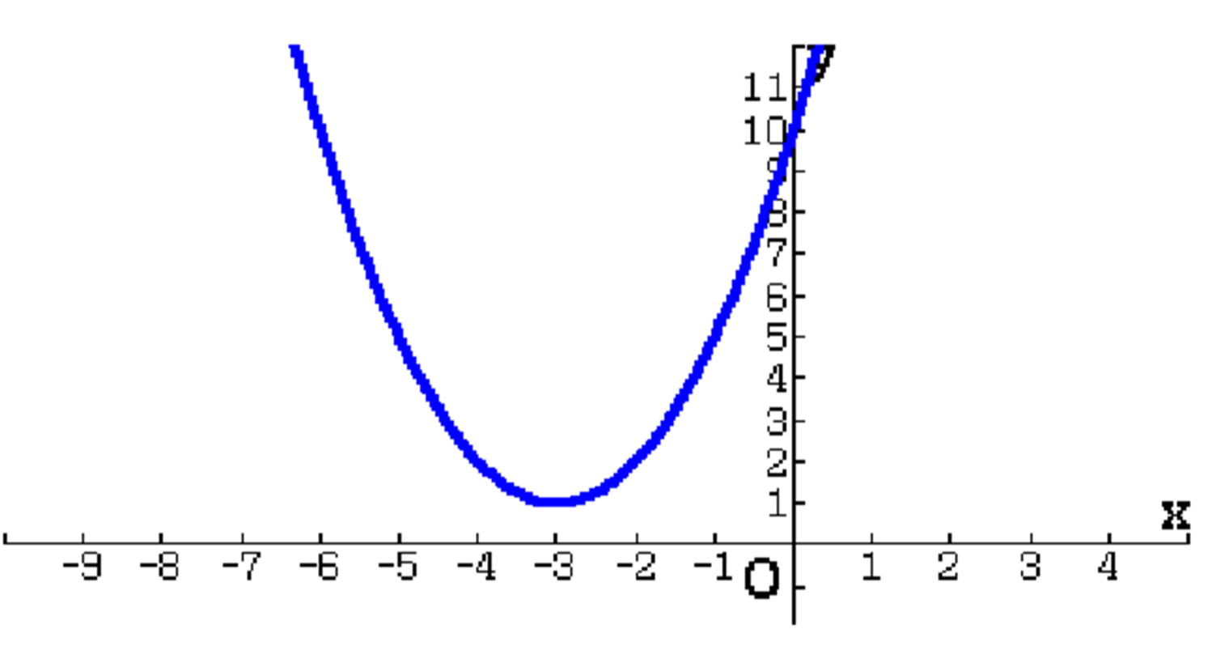
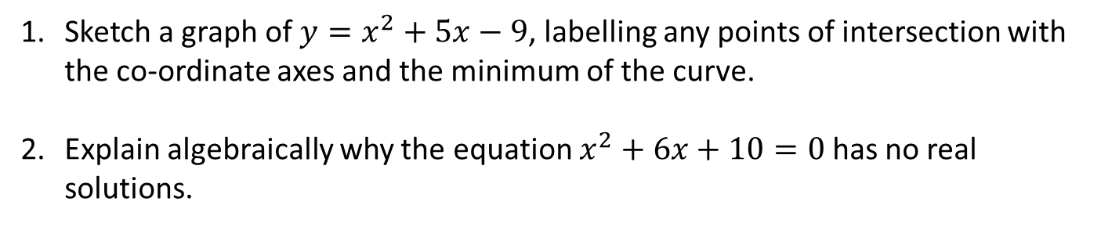
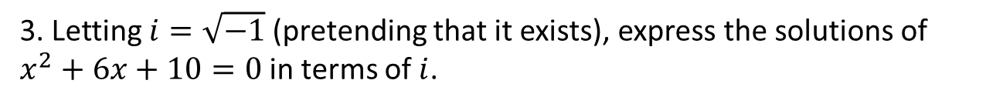
DO NOW:
Sketch a graph of $y=x^{2}+5x−9$, labelling any points of intersection with the co-ordinate axes and the minimum of the curve.
Explain algebraically why the equation $x^{2}+6x+10=0$has no real solutions.
3. Letting $i=\sqrt{−1}$(pretending that it exists), express the solutions of $x^{2}+6x+10=0$in terms of $i$.

Slide 22
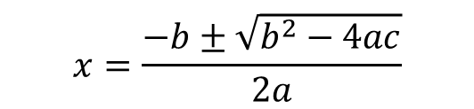

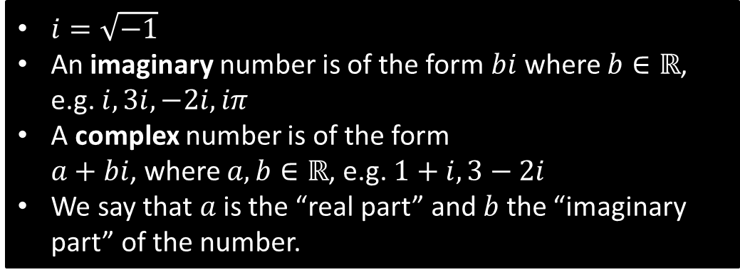
Why complex numbers?
Remember when you used the quadratic formula, and “it broke” when you had a negative discriminant? (the $b^{2}−4ac$ bit)
$$x=\frac{−b±\sqrt{b^{2}−4ac}}{2a}$$
By adding $i=\sqrt{−1}$ to our number system, we can then represent roots of quadratics that we couldn’t previously do so with “real” numbers (i.e. numbers in $ℝ$).
$i=\sqrt{−1}$
An imaginary number is of the form $bi$ where $b∈ℝ$, e.g. $i, 3i, −2i, iπ$
A complex number is of the form
$a+bi$, where $a,b∈ℝ$, e.g. $1+i, 3−2i$
We say that $a$ is the “real part” and $b$ the “imaginary part” of the number.

Slide 23
Video clips
Imaginary Numbers Are Real [Part 1: Introduction]
Imaginary Numbers Are Real [Part 2: A Little History]
Imaginary Numbers Are Real [Part 3: Cardan's Problem]
Imaginary Numbers Are Real [Part 4: Bombelli's Solution]
Imaginary Numbers Are Real [Part 5: Numbers are Two Dimensional]

Slide 24

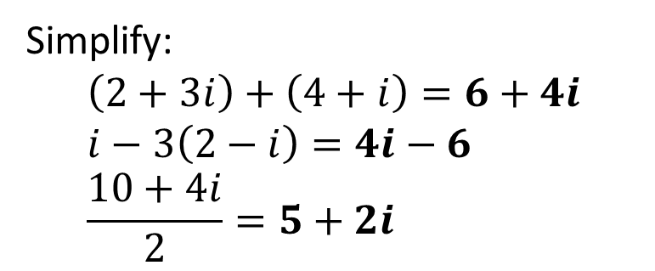
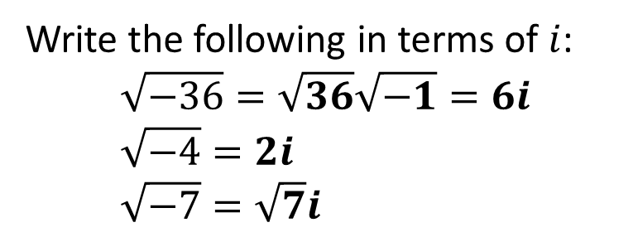
Write the following in terms of $i$:
$$\sqrt{−36}=\sqrt{36}\sqrt{−1}=6i \\ \sqrt{−4}=2i \\ \sqrt{−7}=\sqrt{7}i$$
?
?
?
Simplify:
$$\left(2+3i\right)+\left(4+i\right)=6+4i \\ i−3\left(2−i\right)=4i−6 \\ \frac{10+4i}{2}=5+2i$$
?
?
?

Slide 25
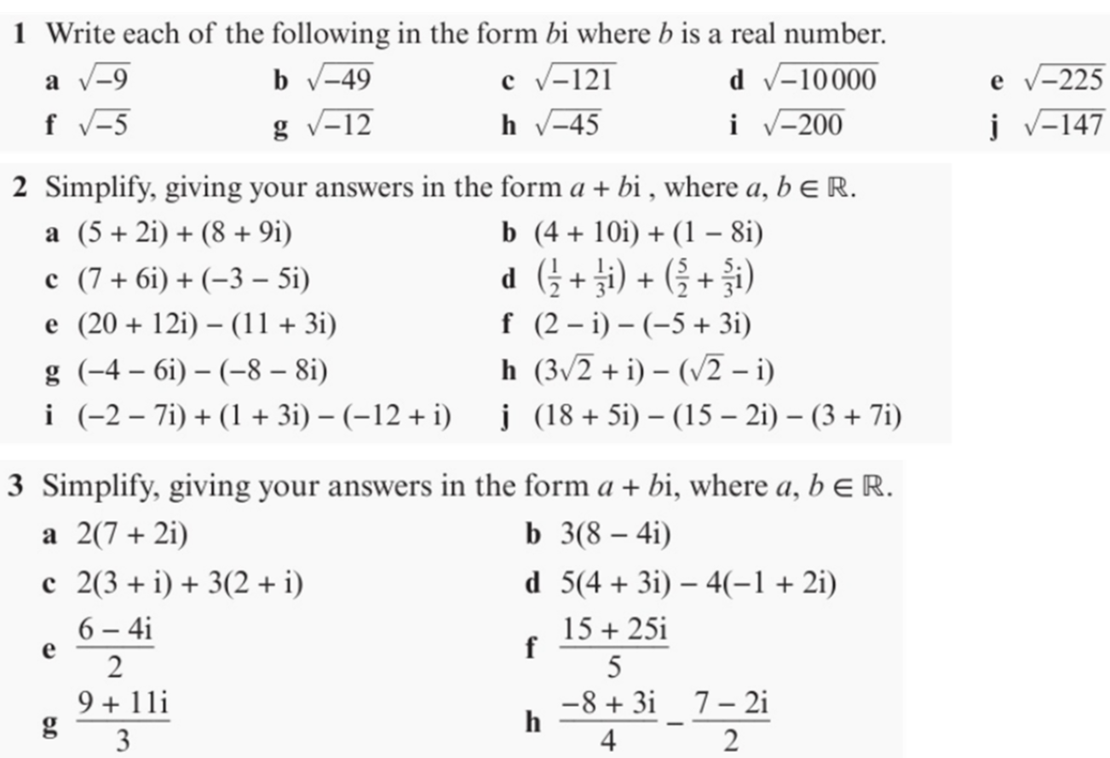
Your turn…

Slide 26
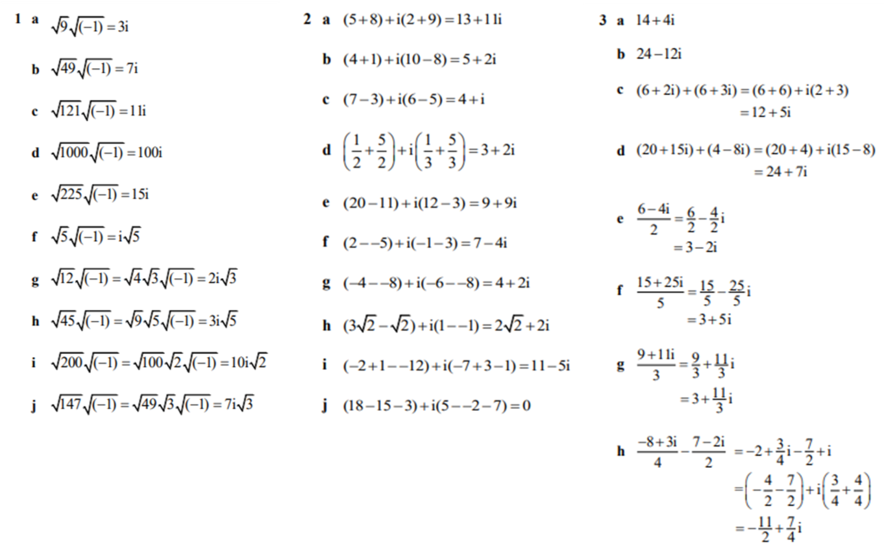
Answers

Slide 27
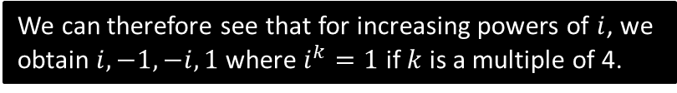
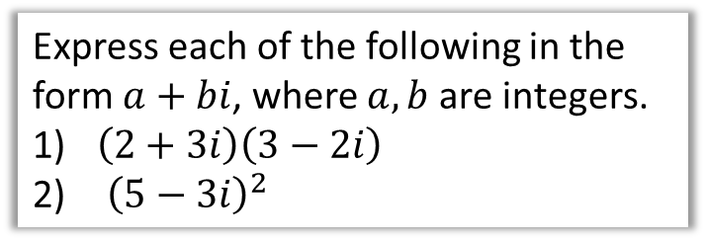
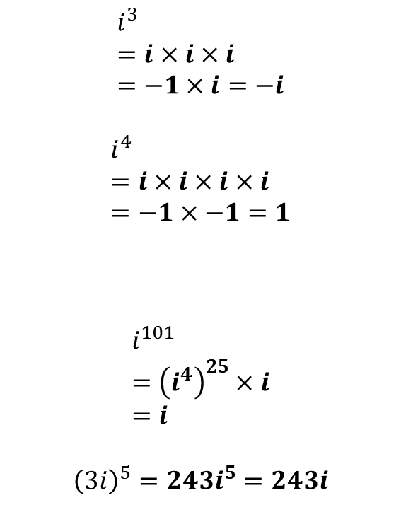

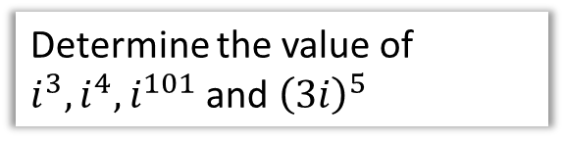
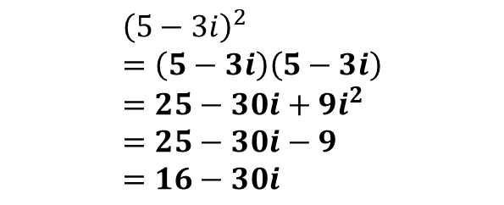
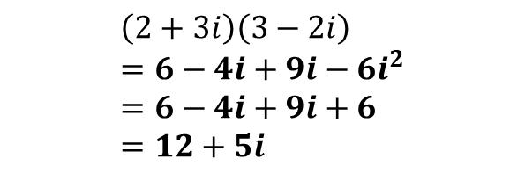
Multiplying complex numbers
Given that $i=\sqrt{−1}$, it follows that $i^{2}=−1$
Determine the value of $i^{3}, i^{4}, i^{101}$ and ${\left(3i\right)}^{5}$
Express each of the following in the form $a+bi$, where $a,b$ are integers.
$\left(2+3i\right)\left(3−2i\right)$
${\left(5−3i\right)}^{2}$
$$i^{3} \\ =i×i×i \\ =−1×i=−i$$
$$i^{4} \\ =i×i×i×i \\ =−1×−1=1$$
$$i^{101} \\ ={\left(i^{4}\right)}^{25}×i \\ =i$$
$${\left(3i\right)}^{5}=243i^{5}=243i$$
?
$$\left(2+3i\right)\left(3−2i\right) \\ =6−4i+9i−6i^{2} \\ =6−4i+9i+6 \\ =12+5i$$
?
?
We can therefore see that for increasing powers of $i$, we obtain $i, −1, −i, 1$ where $i^{k}=1$ if $k$ is a multiple of 4.
$${\left(5−3i\right)}^{2} \\ =\left(5−3i\right)\left(5−3i\right) \\ =25−30i+9i^{2} \\ =25−30i−9 \\ =16−30i$$
?
?
?

Slide 28
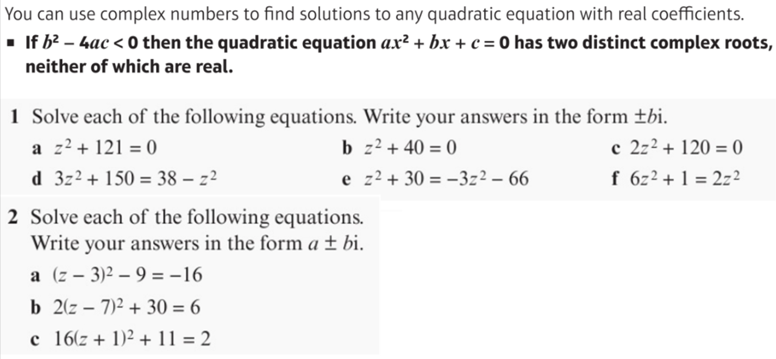
Complex roots

Slide 29
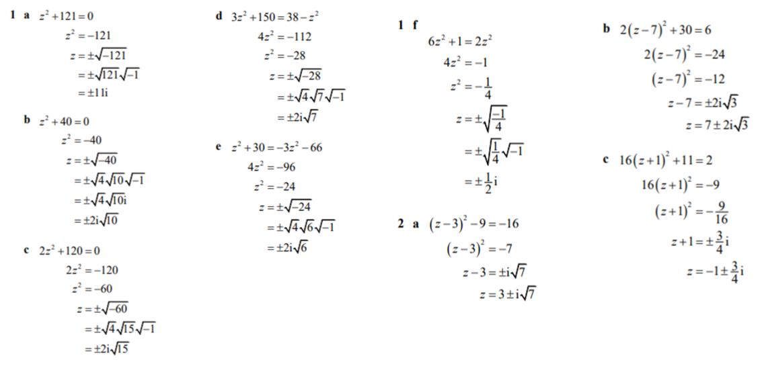
Answers

Slide 30
Any questions?

