Slide 1
AS/A Level Mathematics

Slide 2

AS/A level Mathematics course structure

Slide 3
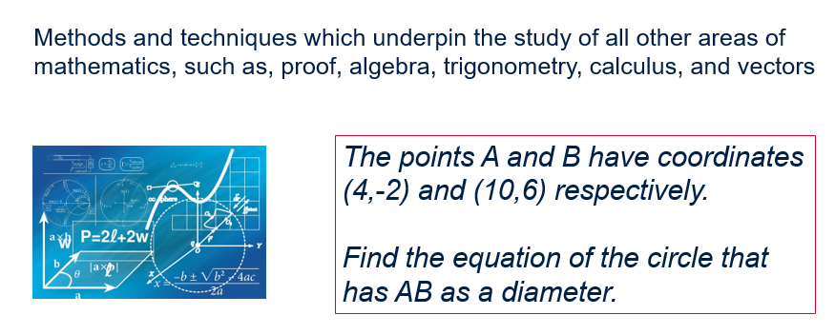
What is Pure Maths?

Slide 4
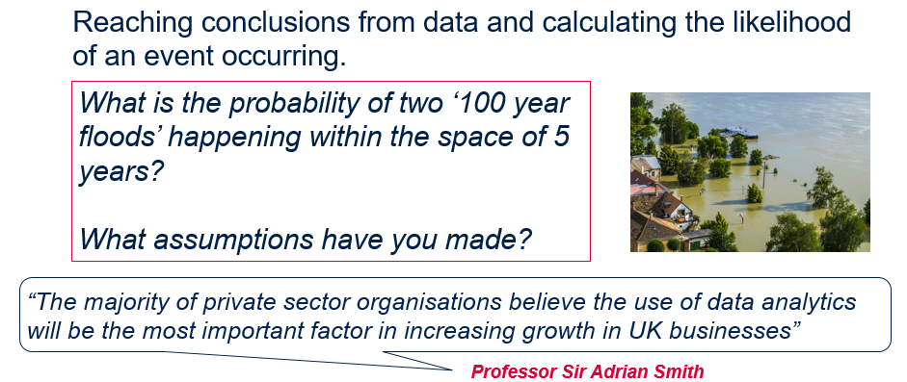
What is Statistics?

Slide 5
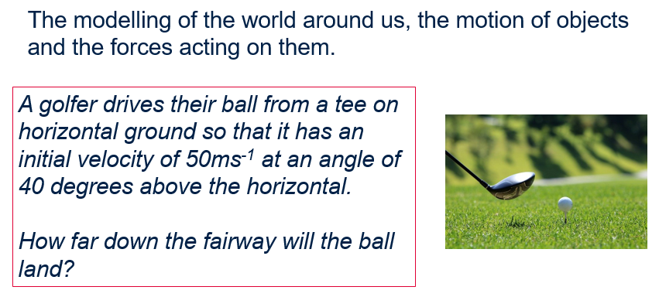
What is Mechanics?

Slide 6
FPSS entry requirements
AS/A level Mathematics
At least grade 6 in GCSE Maths.

Slide 7
This week’s lessons
Lesson 1 – Binomial Expansion (Pure)
Lesson 2 – Binomial Distribution (Statistics)

Slide 8
Binomial Expansion
Lesson 1

Slide 9
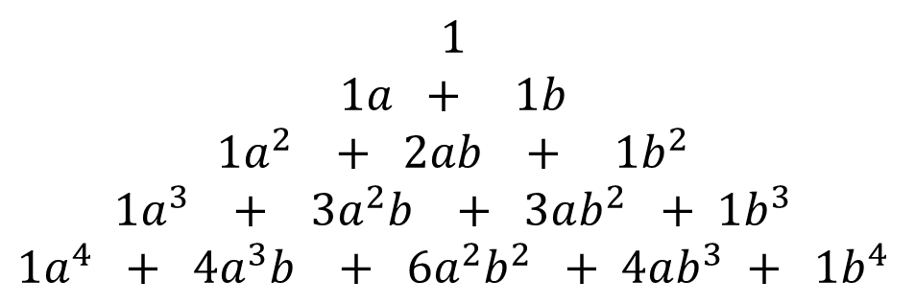
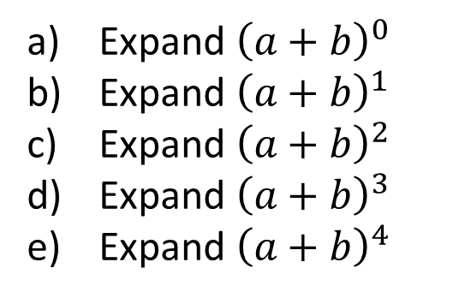
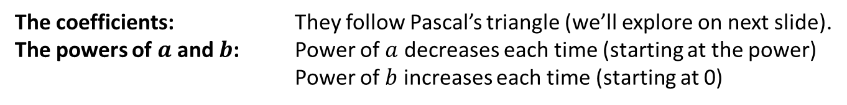
Starter Activity
Expand ${\left(a+b\right)}^{0}$
Expand ${\left(a+b\right)}^{1}$
Expand ${\left(a+b\right)}^{2}$
Expand ${\left(a+b\right)}^{3}$
Expand ${\left(a+b\right)}^{4}$
$$1$$
$$1a + 1b$$
$$1a^{2} + 2ab + 1b^{2}$$
$$1a^{3} + 3a^{2}b + 3ab^{2} + 1b^{3}$$
$$1a^{4} + 4a^{3}b + 6a^{2}b^{2} + 4ab^{3} + 1b^{4}$$
?
?
?
?
?
What do you notice about:
?
The coefficients: They follow Pascal’s triangle (we’ll explore on next slide).
The powers of $a$ and $b$: Power of $a$ decreases each time (starting at the power)
Power of $b$ increases each time (starting at 0)
?

Slide 10
Pascal’s Triangle
In Pascal’s Triangle, each term is the sum of the two terms above.
1
1
1
1
2
1
1
3
3
1
1
4
6
4
1
1
5
10
10
5
1
The mathematical secrets of Pascal's Triangle

Slide 11
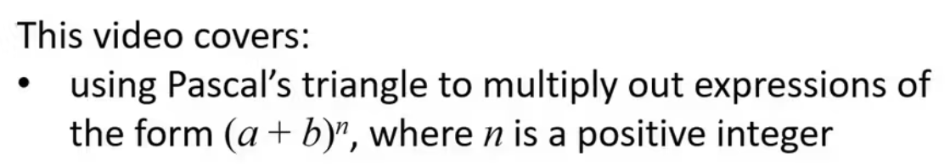
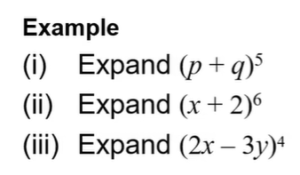
The Binomial expansion
Video

Slide 12
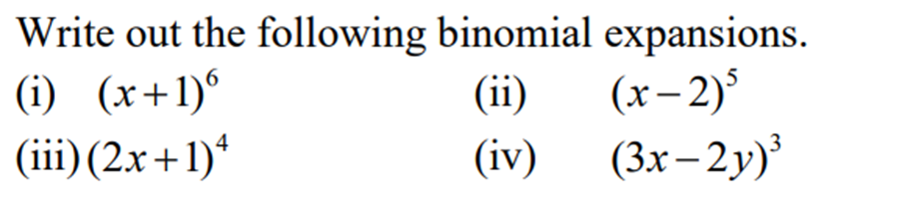
Your turn…

Slide 13
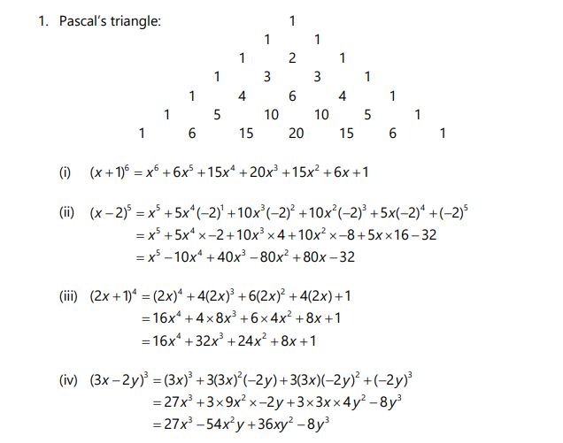
Answers

Slide 14
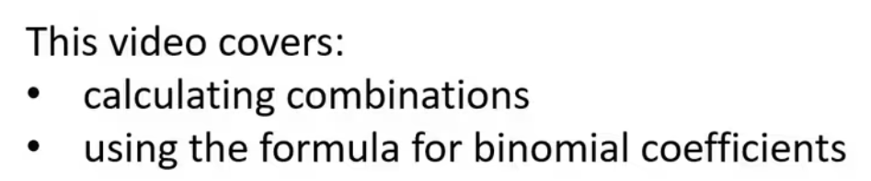
Combinations
Video

Slide 15
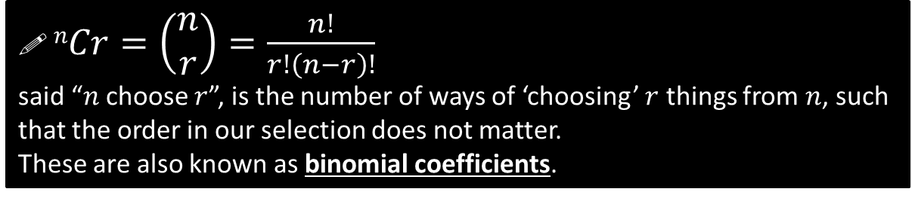
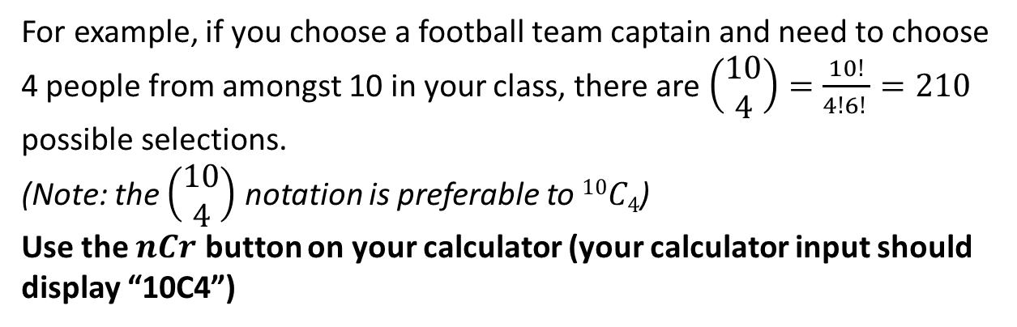
Combinations
For example, if you choose a football team captain and need to choose 4 people from amongst 10 in your class, there are $\left(\begin{matrix}10 \\ 4\end{matrix}\right)=\frac{10!}{4!6! }=210$ possible selections.
(Note: the $\left(\begin{matrix}10 \\ 4\end{matrix}\right)$ notation is preferable to $10C4$)
Use the $nCr$ button on your calculator (your calculator input should display “10C4”)

Slide 16
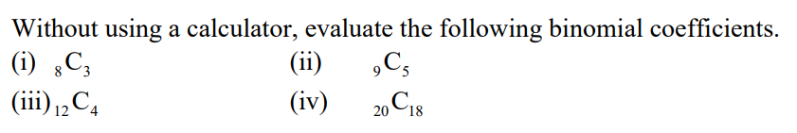
Your Turn

Slide 17
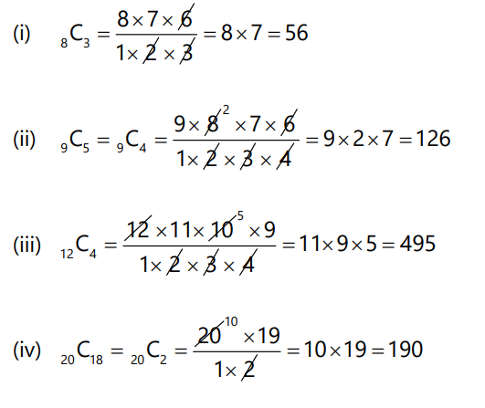
Answers

Slide 18
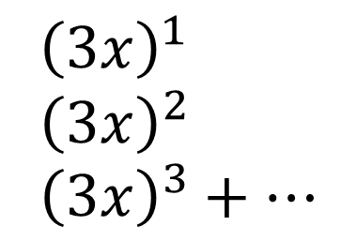
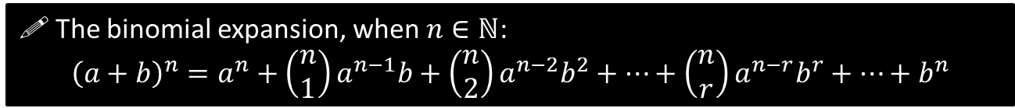
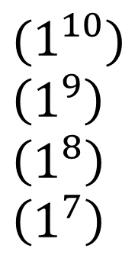
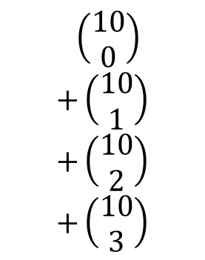

Using Binomial Coefficients to Expand
$ℕ$ is the set of natural numbers, i.e. positive integers. This formula is only valid for positive integers $n$. In Year 2 you will see how to deal with fractional/negative $n$.
! The binomial expansion, when $n∈ℕ$:
$${\left(a+b\right)}^{n}=a^{n}+\left(\begin{matrix}n \\ 1\end{matrix}\right)a^{n−1}b+\left(\begin{matrix}n \\ 2\end{matrix}\right)a^{n−2}b^{2}+…+\left(\begin{matrix}n \\ r\end{matrix}\right)a^{n−r}b^{r}+…+b^{n}$$
Find the first 4 terms in the expansion of ${\left(3x+1\right)}^{10}$, in ascending powers of $x$.
$$\left(\begin{matrix}10 \\ 0\end{matrix}\right) \\ +\left(\begin{matrix}10 \\ 1\end{matrix}\right) \\ +\left(\begin{matrix}10 \\ 2\end{matrix}\right) \\ +\left(\begin{matrix}10 \\ 3\end{matrix}\right)$$
This is exactly the same method as before, except we’ve just had to calculate the Binomial coefficients ourselves rather than read them off Pascal’s Triangle.
$${\left(3x+1\right)}^{10}=$$
$$(1^{10}) \\ \left(1^{9}\right) \\ \left(1^{8}\right) \\ \left(1^{7}\right)$$
$${\left(3x\right)}^{1} \\ {\left(3x\right)}^{2} \\ {\left(3x\right)}^{3}+…$$
$$=1+30x+405x^{2}+3240x^{3}+…$$

Slide 19

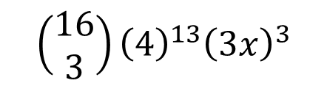



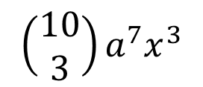



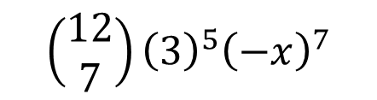

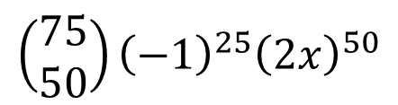

Getting a single term in the expansion
In the expansion of ${\left(a+b\right)}^{n}$ the general term is given by $\left(\begin{matrix}n \\ r\end{matrix}\right)a^{n−r}b^{r}$
Expression
Power of $x$ in term wanted.
Term in expansion
$$\left(\begin{matrix}10 \\ 3\end{matrix}\right){a^{7}x}^{3}$$
?
$${\left(a+x\right)}^{10}$$
$$3$$
Note: The two powers add up to 10.
$$\left(\begin{matrix}75 \\ 50\end{matrix}\right){\left(−1\right)}^{25}{\left(2x\right)}^{50}$$
$${\left(2x−1\right)}^{75}$$
$$50$$
?
$$\left(\begin{matrix}12 \\ 7\end{matrix}\right){\left(3\right)}^{5}{\left(−x\right)}^{7}$$
$${\left(3−x\right)}^{12}$$
$$7$$
?
?
$${\left(3x+4\right)}^{16}$$
$$3$$
$$\left(\begin{matrix}16 \\ 3\end{matrix}\right){\left(4\right)}^{13}{\left(3x\right)}^{3}$$

Slide 20
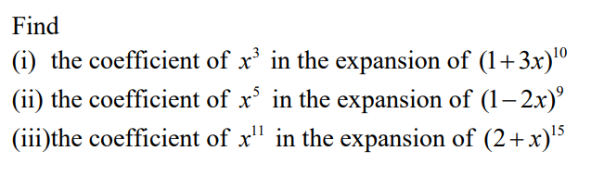
Your turn…

Slide 21
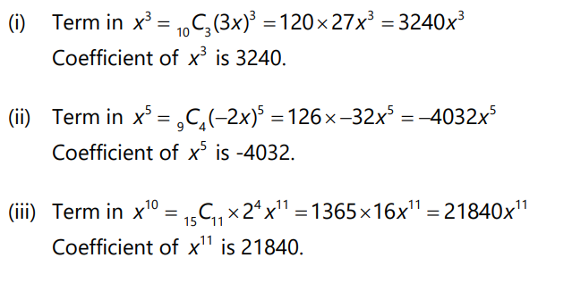
Answers

Slide 22
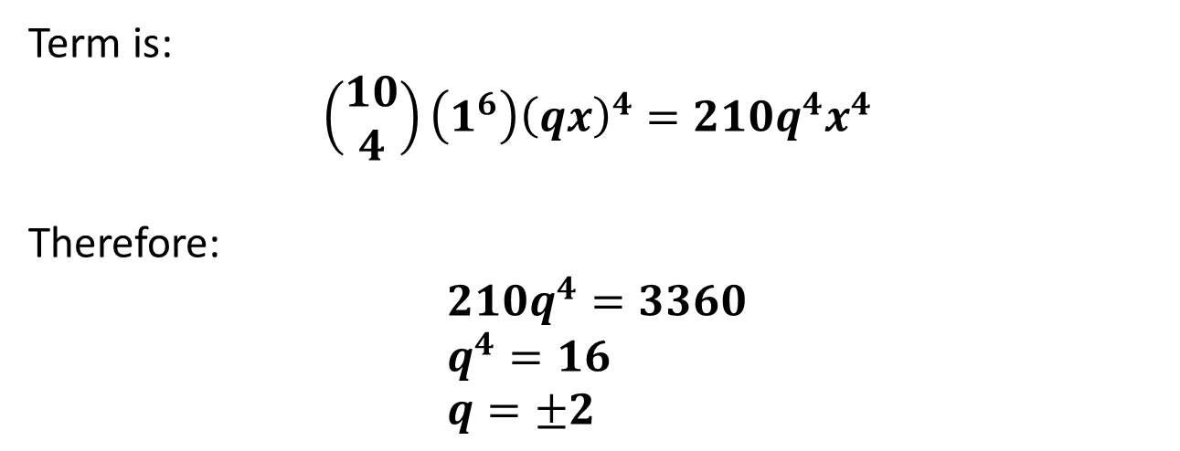
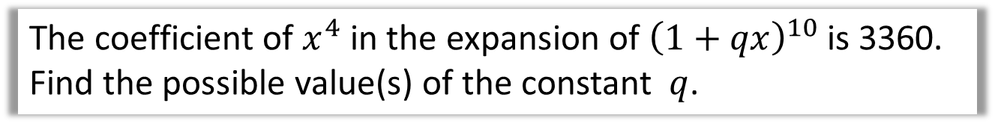
And finally…
The coefficient of $x^{4}$ in the expansion of ${\left(1+qx\right)}^{10}$ is 3360. Find the possible value(s) of the constant $q$.
Term is:
$$\left(\begin{matrix}10 \\ 4\end{matrix}\right)\left(1^{6}\right){\left(qx\right)}^{4}=210q^{4}x^{4}$$
Therefore:
$$210q^{4}=3360 \\ q^{4}=16 \\ q=±2$$
?
?

Slide 23
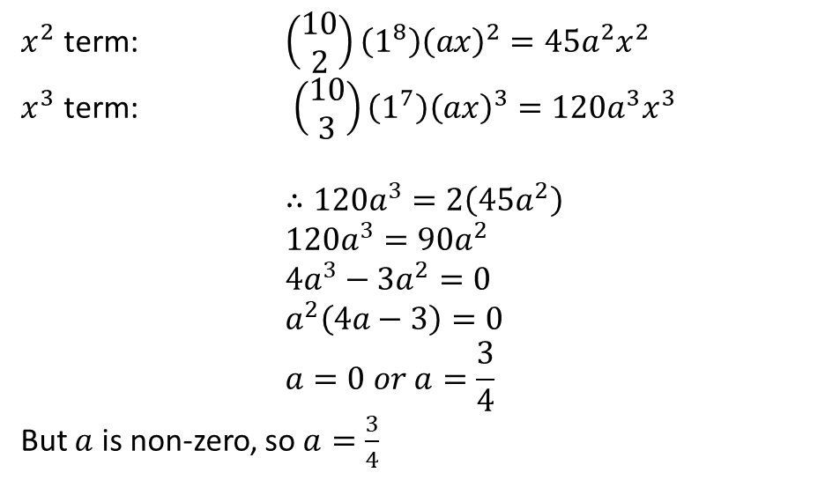
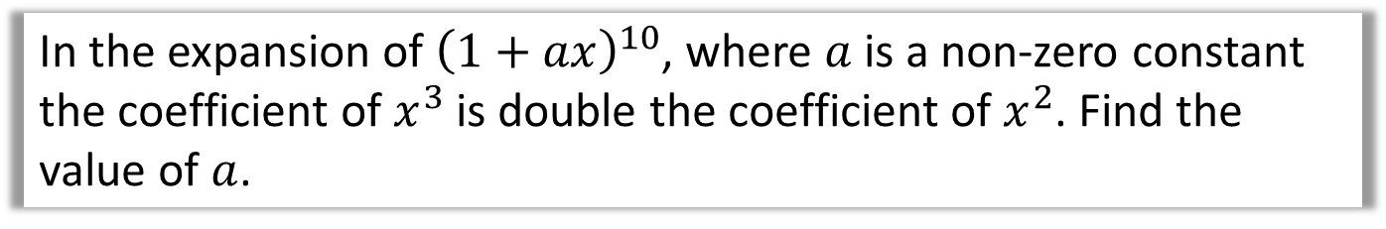
Your turn…
In the expansion of ${\left(1+ax\right)}^{10}$, where $a$ is a non-zero constant the coefficient of $x^{3}$ is double the coefficient of $x^{2}$. Find the value of $a$.
?
$x^{2}$ term: $\left(\begin{matrix}10 \\ 2\end{matrix}\right)\left(1^{8}\right){\left(ax\right)}^{2}=45a^{2}x^{2}$
$x^{3}$ term: $\left(\begin{matrix}10 \\ 3\end{matrix}\right)\left(1^{7}\right){\left(ax\right)}^{3}=120a^{3}x^{3}$
$$∴120a^{3}=2\left(45a^{2}\right) \\ 120a^{3}=90a^{2} \\ 4a^{3}−3a^{2}=0 \\ a^{2}\left(4a−3\right)=0 \\ a=0 or a=\frac{3}{4}$$
But $a$ is non-zero, so $a=\frac{3}{4}$

Slide 24
Any questions?

Slide 25
Binomial distribution
Lesson 2 How is probability used in real life? (Video)

Slide 26
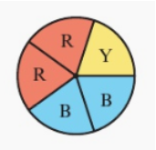
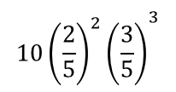



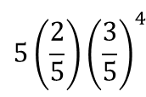
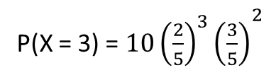
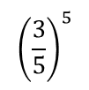
DO NOW
A spinner is spun 5 times. Complete this table of probabilities for the random variable X, the number of times red appears.
x | 0 | 1 | 2 | 3 | 4 | 5
P(X = x)
0.07776
0.2592
0.3456
0.2304
0.0768
0.01024
P(X = 0) = P($\overline{R}\overline{R}\overline{R}\overline{R}\overline{R})=$
$${\left(\frac{3}{5}\right)}^{5}$$
$${5\left(\frac{2}{5}\right)\left(\frac{3}{5}\right)}^{4}$$
P(X = 1) = P($R\overline{R}\overline{R}\overline{R}\overline{R}) or P\left(\overline{R}R\overline{R}\overline{R}\overline{R}\right) or \text{P}\text{(}\overline{R}\overline{R}R\overline{R}\overline{R}) or \text{P}\text{(}\overline{R}\overline{R}\overline{R}R\overline{R}) \text{or} \text{P}\text{(}\overline{R}\overline{R}\overline{R}\overline{R}R)=$
P(X = 2) = P($RR\overline{R}\overline{R}\overline{R}) or P\left(R\overline{R}R\overline{R}\overline{R}\right) or \text{P}\text{(}R\overline{R}\overline{R}R\overline{R}) or \text{P}\text{(}\text{R}\overline{R}\overline{R}\overline{R}R) \text{or} \text{P}\text{(}\overline{R}RR\overline{R}\overline{R}) or …=$
$${{10\left(\frac{2}{5}\right)}^{2}\left(\frac{3}{5}\right)}^{3}$$
P(X = 3) = ${{10\left(\frac{2}{5}\right)}^{3}\left(\frac{3}{5}\right)}^{2}$
P(X = 4) = ${5\left(\frac{2}{5}\right)}^{4}\left(\frac{3}{5}\right)$
P(X = 5) $={\left(\frac{2}{5}\right)}^{5}$

Slide 27
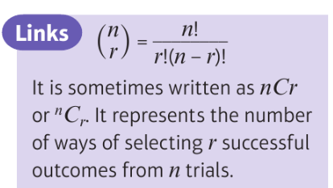
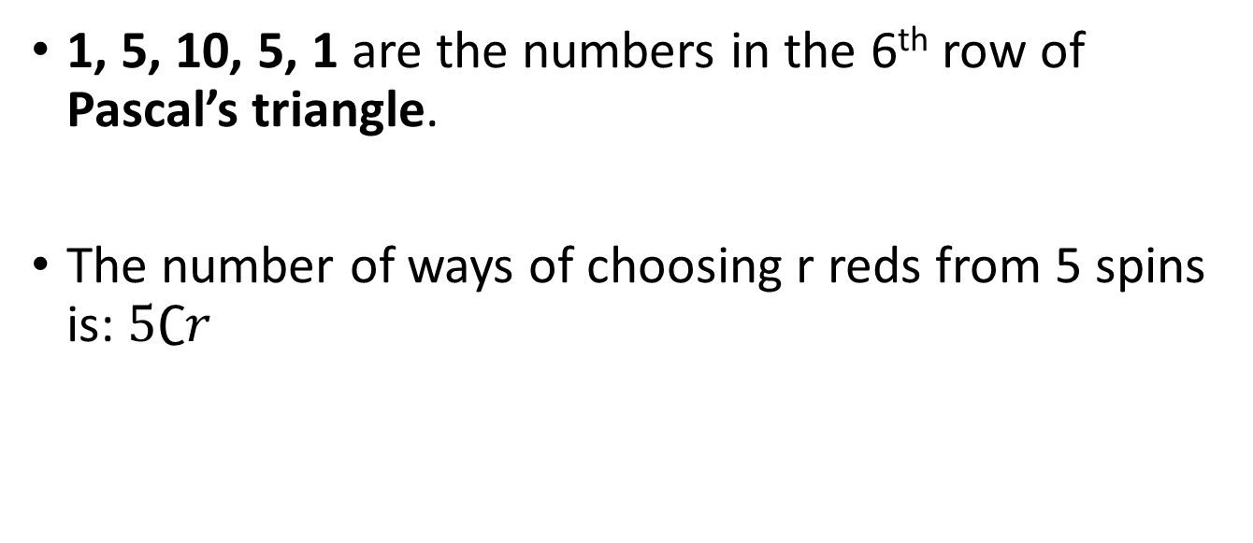
The Binomial Distribution
1, 5, 10, 5, 1 are the numbers in the 6th row of Pascal’s triangle.
The number of ways of choosing r reds from 5 spins is: $5∁r$
On your calculator check 6C2 = 15:
Casio fx-85GT/CLASSWIZZ:
6 SHIFT ÷ 2 =
Casio fx-CG50:
In menu 1, OPTN F6(more options) F3(Probability) F3(nCr) Use arrow keys to input 6 in front and 2 after then EXE

Slide 28
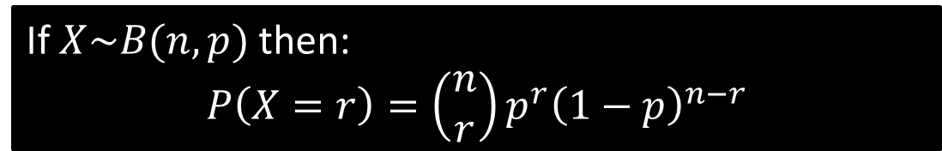
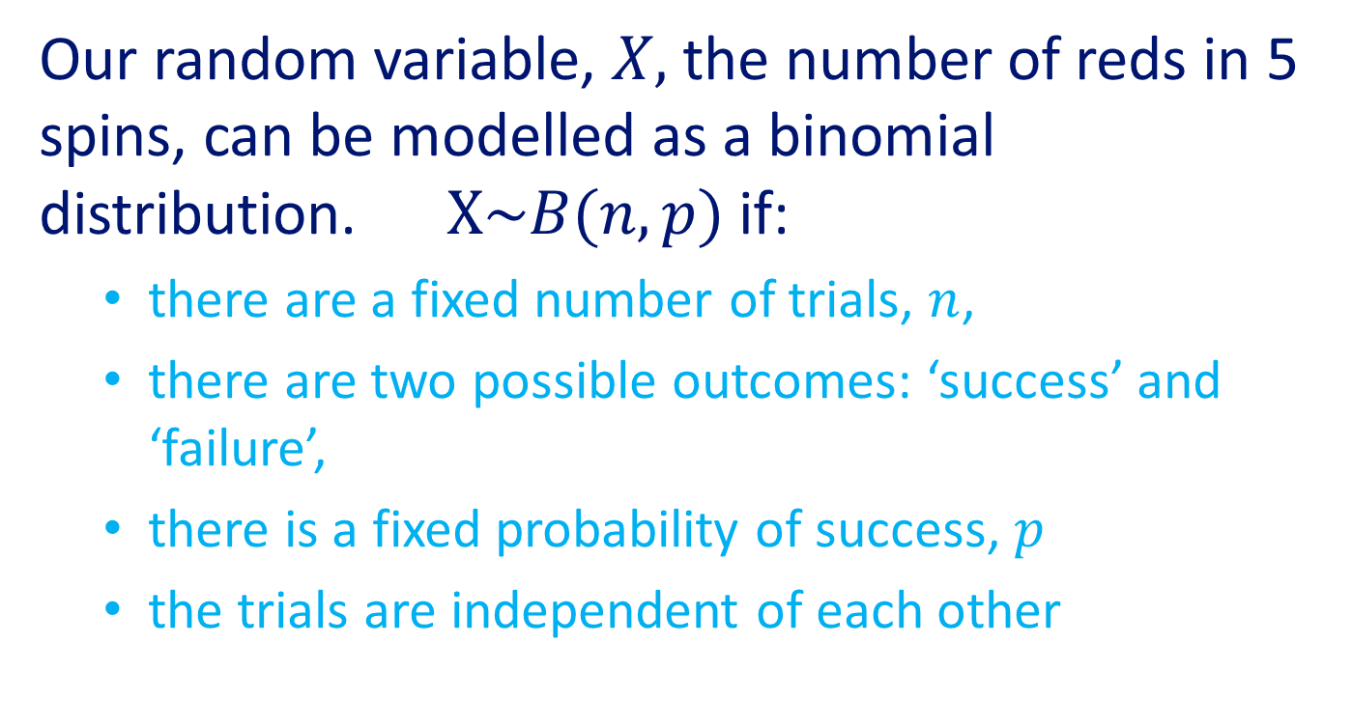
The Binomial Distribution
Our random variable, $X,$ the number of reds in 5 spins, can be modelled as a binomial distribution. $X\sim B(n,p)$ if:
  there are a fixed number of trials, $n$,
  there are two possible outcomes: ‘success’ and ‘failure’,
  there is a fixed probability of success, $p$
  the trials are independent of each other
If $X\sim B(n,p)$ then:
$$P\left(X=r\right)=\left(\begin{matrix}n \\ r\end{matrix}\right)p^{r}{\left(1−p\right)}^{n−r}$$

Slide 29
The Binomial Distribution
Video

Slide 30
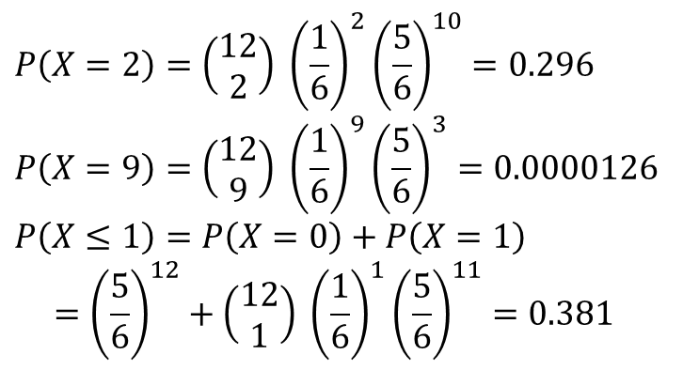
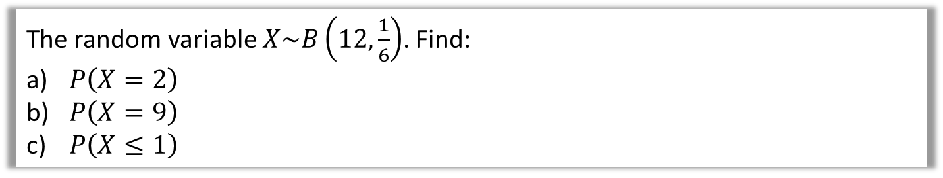
Further Examples
The random variable $X\sim B\left(12,\frac{1}{6}\right)$. Find:
$P\left(X=2\right)$
$P\left(X=9\right)$
$P\left(X≤1\right)$
$$P\left(X=2\right)=\left(\begin{matrix}12 \\ 2\end{matrix}\right) {\left(\frac{1}{6}\right)}^{2}{\left(\frac{5}{6}\right)}^{10}=0.296 \\ P\left(X=9\right)=\left(\begin{matrix}12 \\ 9\end{matrix}\right) {\left(\frac{1}{6}\right)}^{9}{\left(\frac{5}{6}\right)}^{3}=0.0000126 \\ P\left(X≤1\right)=P\left(X=0\right)+P\left(X=1\right) \\ ={\left(\frac{5}{6}\right)}^{12}+\left(\begin{matrix}12 \\ 1\end{matrix}\right) {\left(\frac{1}{6}\right)}^{1}{\left(\frac{5}{6}\right)}^{11}=0.381$$
a
?
b
?
c
?

Slide 31
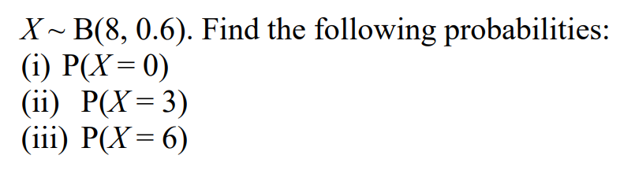
Your turn…

Slide 32
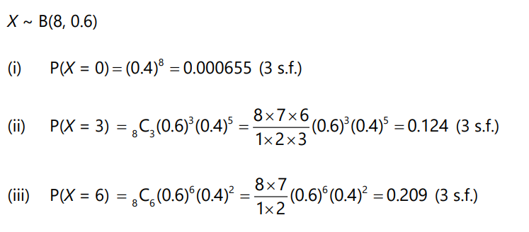
Answers

Slide 33
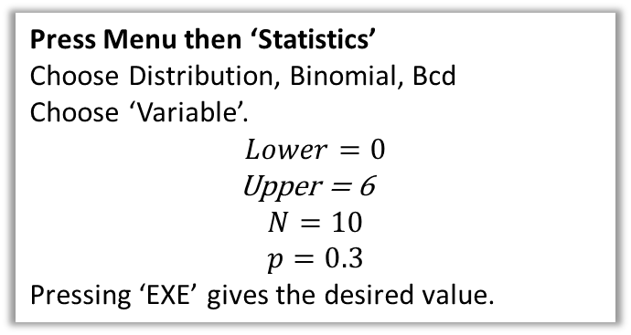
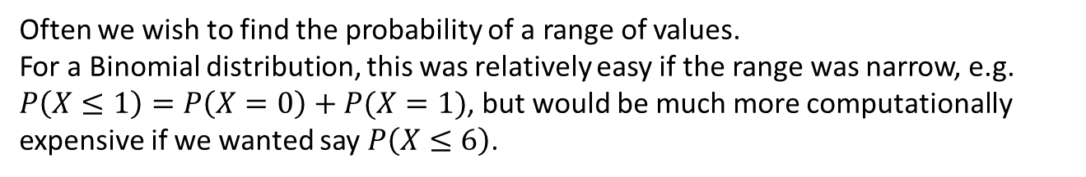
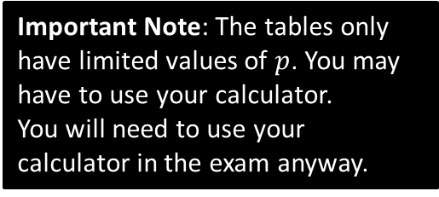
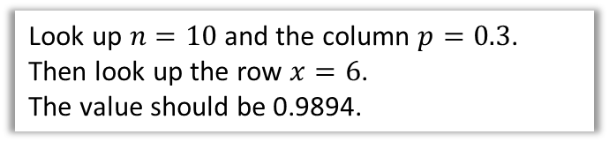
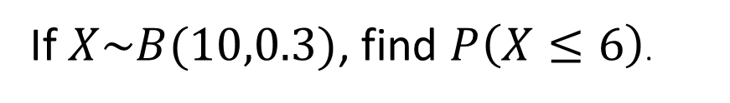
Cumulative Probabilities
Often we wish to find the probability of a range of values.
For a Binomial distribution, this was relatively easy if the range was narrow, e.g. $P\left(X≤1\right)=P\left(X=0\right)+P(X=1)$, but would be much more computationally expensive if we wanted say $P\left(X≤6\right)$.
If $X\sim B(10,0.3)$, find $P\left(X≤6\right)$.
How to calculate on your fx-CG50:
Using tables
Press Menu then ‘Statistics’
Choose Distribution, Binomial, Bcd
Choose ‘Variable’.
$$Lower=0$$
Upper = 6
$$N=10 \\ p=0.3$$
Pressing ‘EXE’ gives the desired value.
Look up $n=10$ and the column $p=0.3$.
Then look up the row $x=6$.
The value should be 0.9894.
Important Note: The tables only have limited values of $p$. You may have to use your calculator.
You will need to use your calculator in the exam anyway.

Slide 34
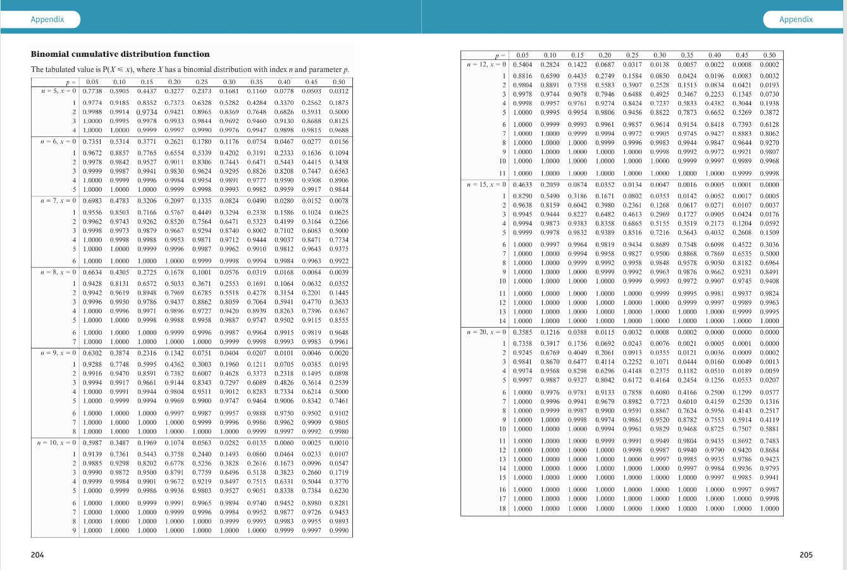
Tables

Slide 35
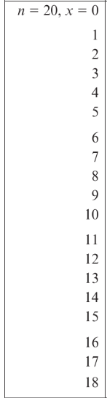

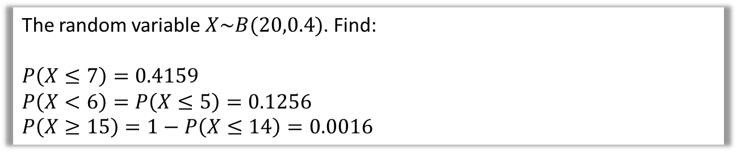
Cumulative Probabilities
The random variable $X\sim B(20,0.4)$. Find:
$$P\left(X≤7\right)=0.4159$$
$$P\left(X<6\right)=P\left(X≤5\right)=0.1256 \\ P\left(X≥15\right)=1−P\left(X≤14\right)=0.0016$$
?
?
?

Slide 36




Given that $X\sim B\left(25,0.25\right)$
$$P\left(X=6\right)=P\left(X≤6\right)−P\left(X≤5\right) \\ =0.1828$$
$P\left(X>20\right)=1−P\left(X≤20\right)$= 0
$$P\left(6<X≤10\right)=P\left(X≤10\right)−P\left(X≤6\right)$$
$=0.4092$
?
?
?

Slide 37


Cumulative Probabilities
Quickfire Questions
Write the following in terms of cumulative probabilities, e.g. $P\left(X<7\right)=P\left(X≤6\right)$
$$P\left(X<5\right)=P\left(X≤4\right)$$
$$P\left(X≥7\right)=1−P\left(X≤6\right)$$
$$P\left(X>7\right)=1−P\left(X≤7\right)$$
$$P\left(10≤X<20\right)=P\left(X≤19\right)−P\left(X≤9\right)$$
?
?
$$P\left(10≤X≤20\right)=P\left(X≤20\right)−P\left(X≤9\right)$$
$$P\left(X=100\right)=P\left(X≤100\right)−P\left(X≤99\right)$$
$$P\left(20<X<30\right)=P\left(X≤29\right)−P\left(X≤20\right)$$
“at least 30” $=P\left(X≥30\right)=1−P\left(X≤29\right)$
“greater than 30” $=P\left(X>30\right)=1−P\left(X≤30\right)$
?
?
?
?
?
?
?

Slide 38

Your turn…
Worksheet

Slide 39
Your turn…
Worksheet

Slide 40

Answers

Slide 41



Slide 42
Any questions?

