Slide 1


GCSEPod
1000s of “pods” either on computer/laptop or app on mobile
Nearly every GCSE subject covered
Each video less than 5 mins
Questions to check understanding
Regular use will improve grades – the biggest user of GCSEPod last year was also the best performer in terms of exam results
Pre-learn or consolidate knowledge
Check and Challenge – testing knowledge gained
Notes:
DAF

Slide 2
GCSEPod – logging on
Log on using Microsoft Edge
Select “Sign in with Office 365”
Use usual school email and password
Notes:
DAF

Slide 3
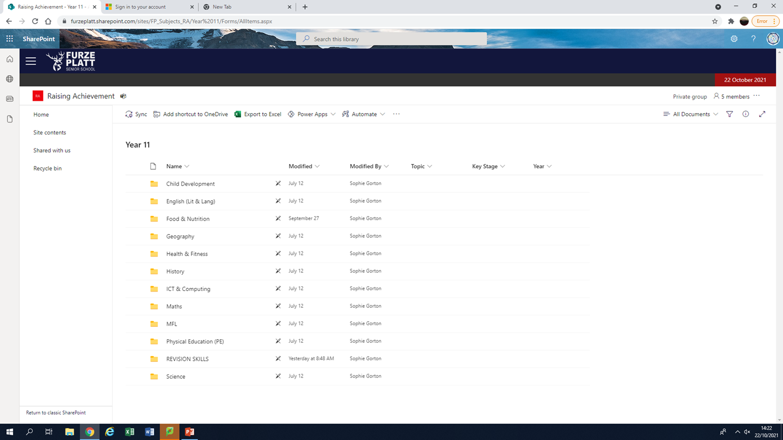
Explore FP Cloud
Raising Achievement have put up revision resources for every subject

Slide 4
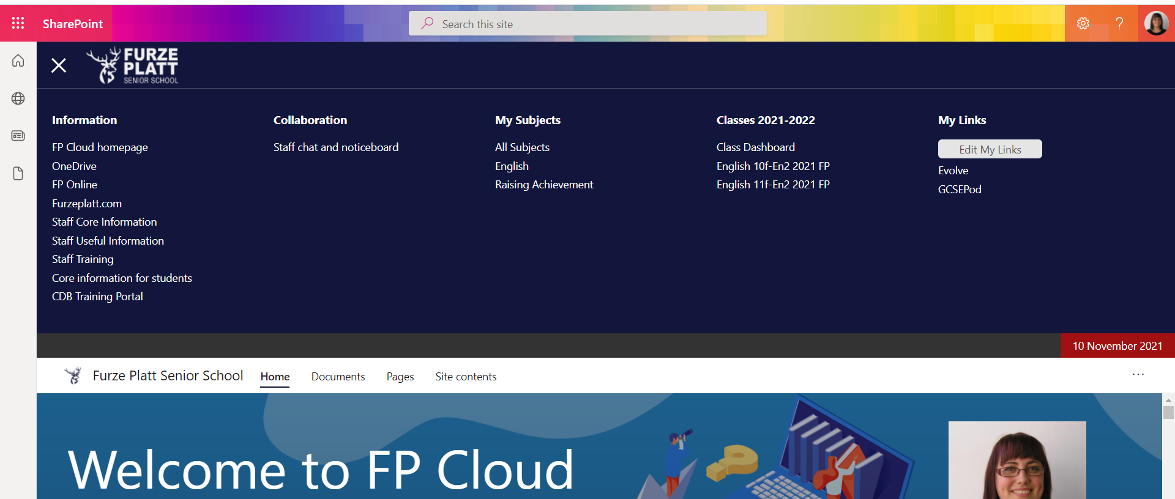
Click on: Core Information for Students

Slide 5
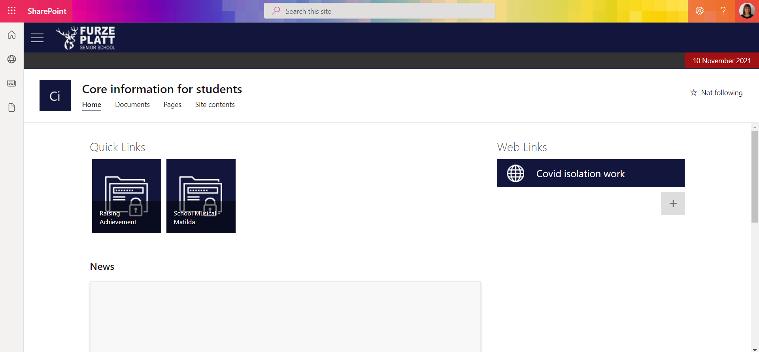
Click: Raising Achievement

Slide 6
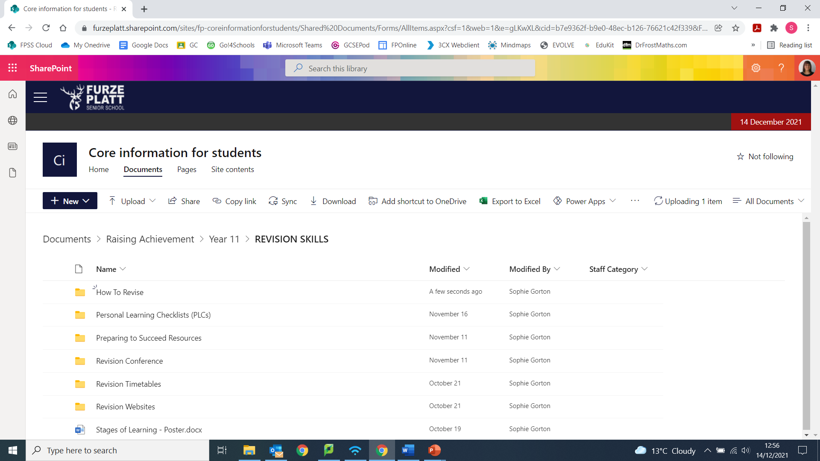
Revision Skills folder
Videos on “how to”
Revise
Use PLCs
Set up a Revision Timetable
and lots more……

Slide 7
Need more support?
Debbie Feather – Raising Achievement Manager
debbie.feather@furzeplatt.net
Students - come visit us in
Raising Achievement (RA)
English Block, Top Floor
Notes:
Before school, break time and after school – there is nearly always someone in Raising Achievement that you can come and talk to. We have many of the revision books, if you would like to come and see which book/s would work best for you before purchasing, and are always here for advice and academic support.

