Slide 1
Study routines during the holidays

Slide 2
Christmas is almost here!
DO:
Relax and enjoy yourself
Take a break from working
Be merry!
AND ALSO:
Do keep up the study habits and routines…
Get your work done that needs doing
Revisit past content

Slide 3
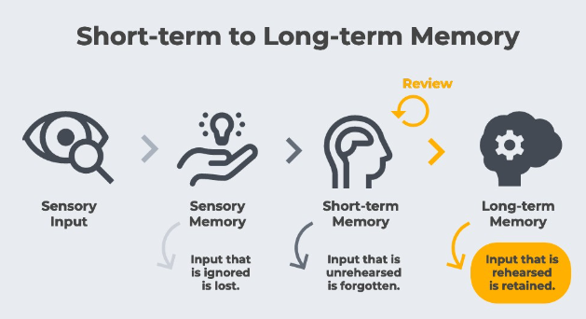
Your memory

Slide 4

York University’s Rule of 8 – why do they suggest this routine?
8hrs of sleep
8hrs of study/revisiting learning
8hrs for yourself

Slide 5
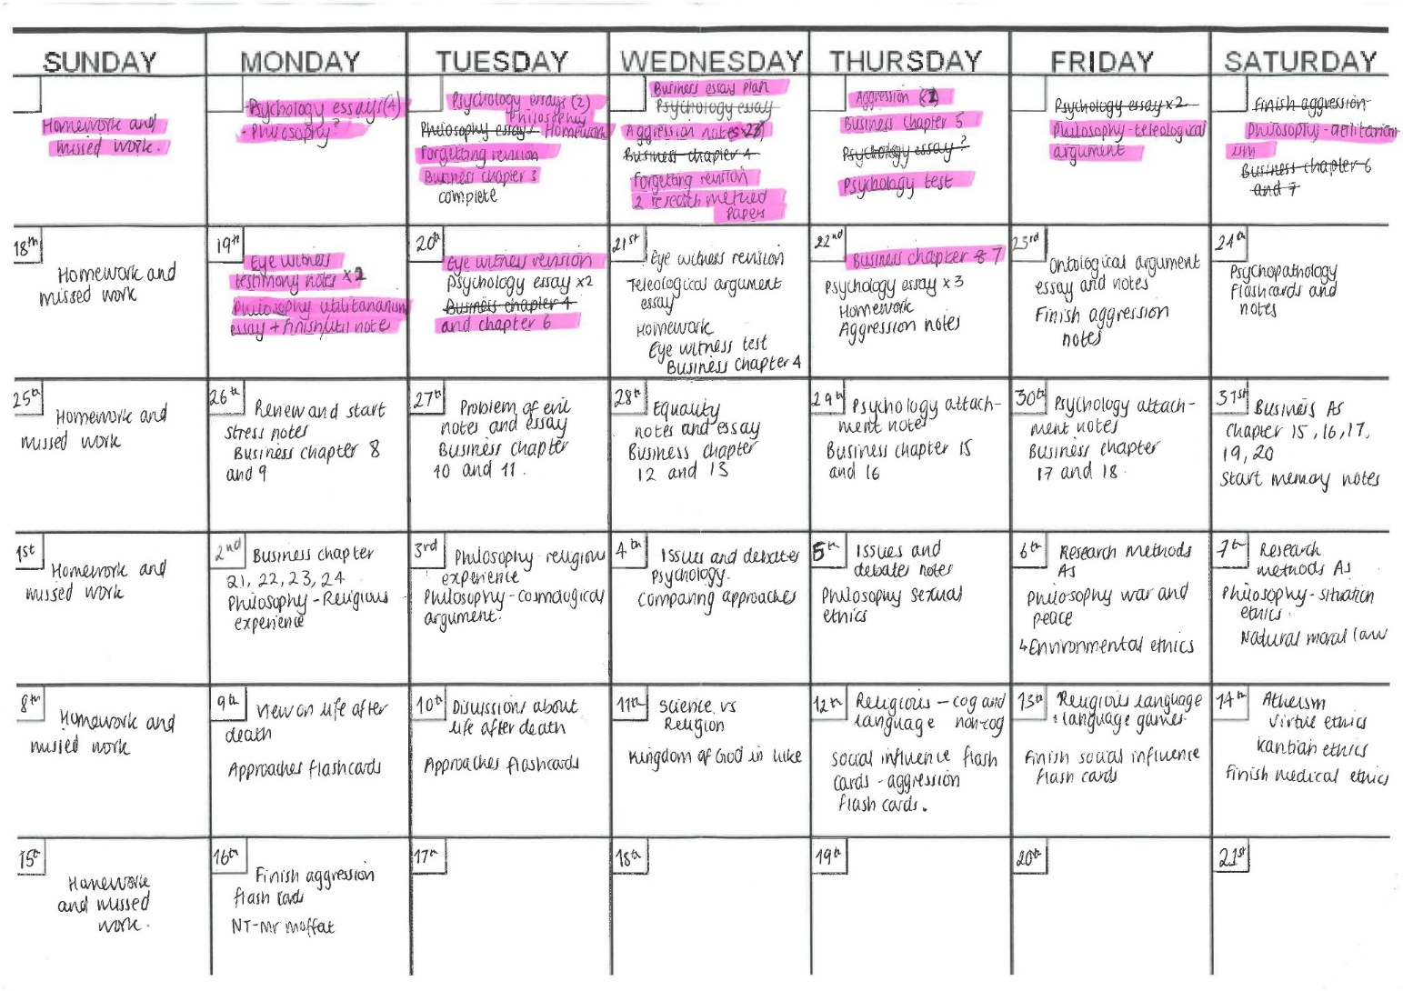
Year 13 – 22 days until your PPEs (excluding weekends)
Create a revision schedule before you get to Christmas and keep to it.
You need to bear in mind when you have family activities / paid work and plan this in to your schedule.

Slide 6
Year 12 – no exams, but important to keep study habits going
Create a home learning schedule so that you can get everything done over the break.

Slide 7
Before planning your timetables…
Review your PLCs / specifications to identify where your weakest areas of study are. Speak to your teachers if you do not have these.
How do you know that these are weak areas? Are you relying on gut instinct or have you tested yourself recently?
You should then vary what you study/revise in order to maximise your attention.
Consider how you might use the pomodoro technique to assist you with this – especially if you think you have a short attention span!

Slide 8
Learning needs to be transformational – if you write notes/read notes you will not remember and be able to retrieve this.
Level 1 – I READ through my notes
Level 2 – I MAKE NOTES from what I read
Level 3 – I TRANSFORM my notes into another format e.g. diagrams, lists, mnemonics, flash cards, tables
What level are you currently at in your own revision process?
Give a number and letter level.
Level a – I answer past questions but avoid hard ones
Level b - I answer hard past questions until I get it right
Level c – I use mark schemes to help me improve my answers
Level d – I use Examiner reports and mark schemes
Level e – I practise AGAIN and AGAIN until I KNOW I have got it right & seek support when I need it.

Slide 9
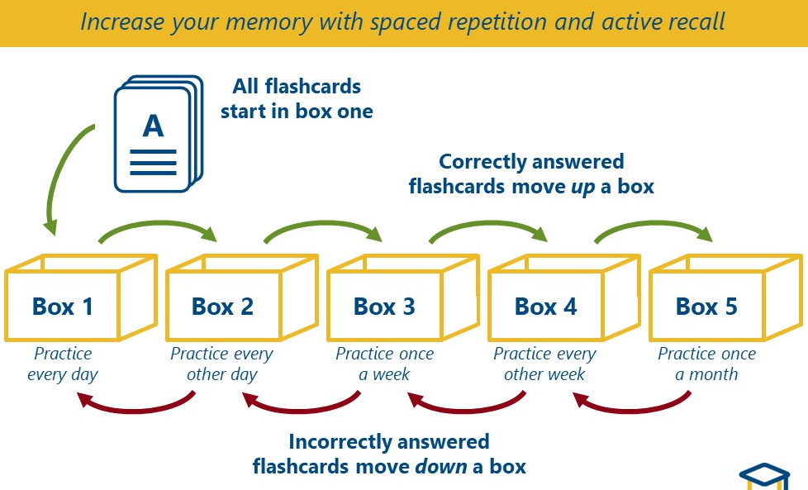
Flashcard properly!

Slide 10
Elaborate!
Rehearsal is key to any retrieval.
When engaging with information, elaborate:
  What does it reveal? What are the implications of this information? What happens before/next?
  Why is this significant? Why else?
  How does it connect to other parts of the course? How does it build on to what I’ve already learnt? How does it differ from other issues/concepts?
This should be spoken or written down to ensure your brain is active.

Slide 11
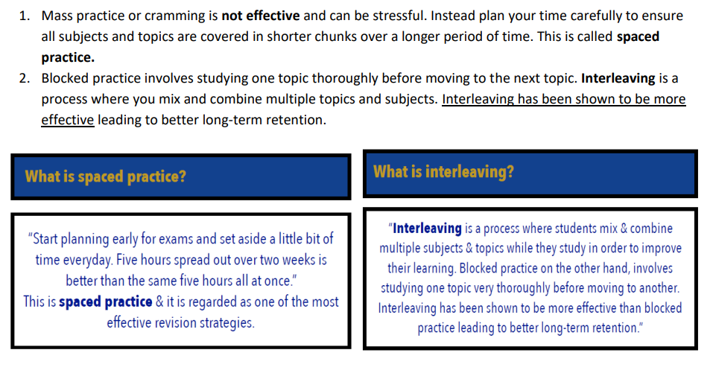
Don’t cram!

Slide 12
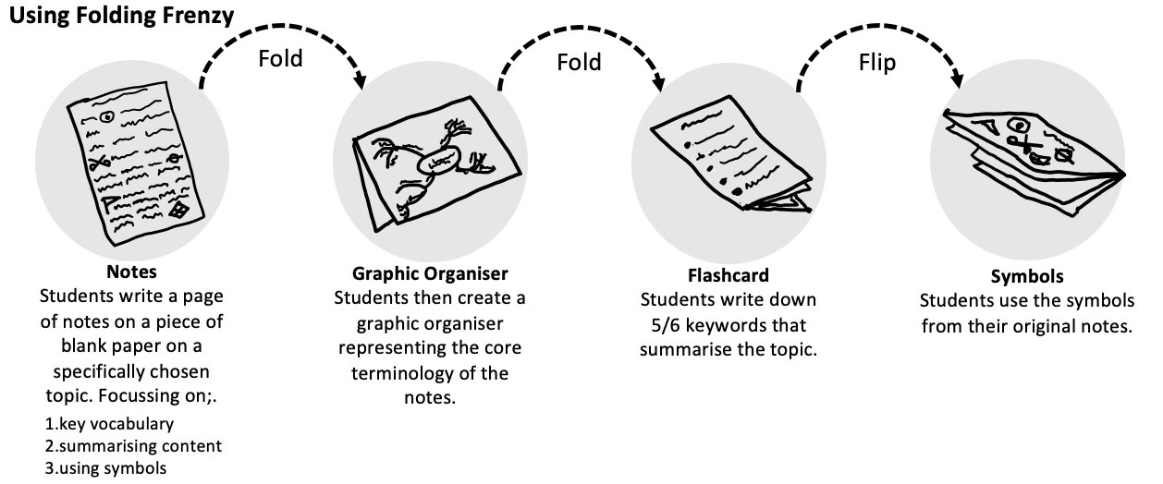
Folding Frenzy
Then:
Test your knowledge and understanding through questioning yourself on key content.
Use the symbols/keywords as memory hooks and check your understanding through unfolding.
Get others to test you too.

Slide 13
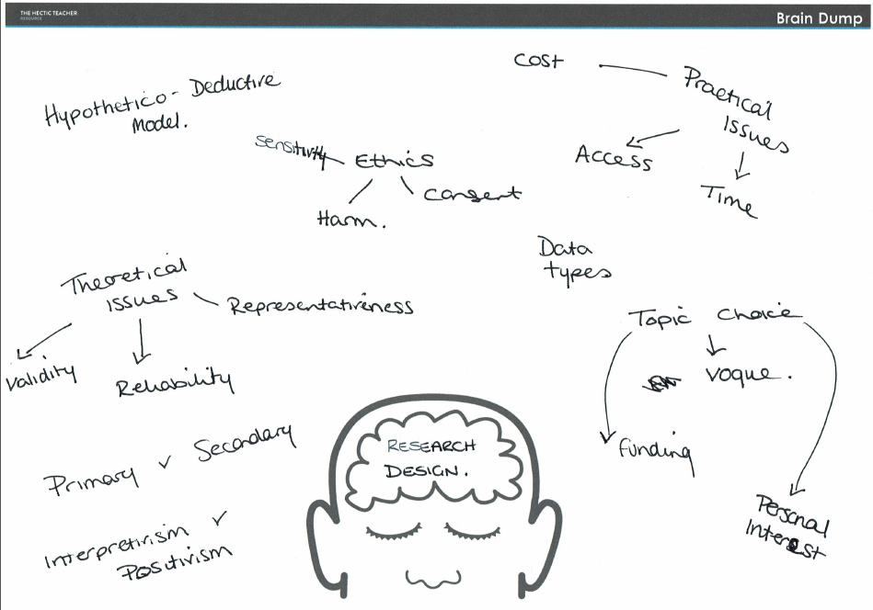
Brain dumps – write everything you know down. Check for gaps and correct in a second colour.

Slide 14
Past paper questions (PPQs)
Do you know:
  Component parts of questions? I.e. how to answer the different types? Structures?
  Which question types you are being asked in the exams?
  Where to get past papers? On the exam board website? Teachers? FP Cloud?
Complete whole PPQs, or complete component parts (i.e. main body paragraphs, conclusions after thorough planning) to ensure that you are targeting weak areas.

Slide 15
Some advice for procrastination:
Start with the unpleasant activities first – get them over and done with!
Set yourself time limits to complete the task by – that way the end is always in sight!
Write a daily to-do list with a tangible reward at the end of the list to keep yourself motivated through the difficult tasks.
Think about where you are studying – if there are distractions, deal with them.
Treat your learning as important – it is what will give you the success you need to progress in life. Dedicate time to it.

Slide 16
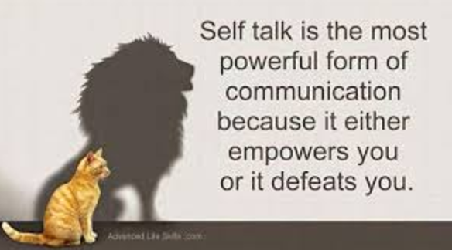
Feeling stressed? Try “self-talk”
EVERY LITTLE HELPS – MARGINAL GAINS MATTER
THE HARDER I WORK, THE BETTER I GET
IF I USE CHRISTMAS WELL, I WILL FEEL SO MUCH BETTER

Slide 17
Your Christmas to do:
Have you:
Created your study timetable?
Identified when you cannot work to establish when you need to work.
Got all PLCs that are needed for your upcoming PPEs (or for directing study – Y12).
Identified when the fun is happening so that you have things to work towards.
Got your revision resources, past paper questions, mark schemes, flashcards organised so that you can DO.

