Slide 1
Careers in Berkshire
Local Labour Market Information
2025
Notes:
Gatsby Benchmark 2, Learning from career and labour market information
Labour Market Information (LMI) is one of the areas that many educators and careers professionals struggle with, let alone parents or learners.

Slide 2
The purpose of this presentation is for schools and young people to understand the local Berkshire Labour Market. Highlighting:
Top employers
Different types of job postings
Diversity and inclusion in the workplace
The current landscape of the job market
STEM jobs and education
Common skills shortages and surplus
Specialised skills shortages and surplus
Apprenticeship postings
Niche labour market information
Jobs and skills that will be required in Berkshire in the future
The data range is from 2024-2025
Introduction
Notes:
What is LMI?
In its simplest form it is information on :-
• What skills employers are looking for and what jobs are available
• Wage rates, working hours, holiday entitlement etc
• What skills gaps exist and what skills are expected to be needed in the future.

Slide 3

The Berkshire area
This pack provides information on careers in the Berkshire area.
Berkshire stretches from Hungerford in the West to Slough in the East.
Berkshire
Notes:
Berkshire Opportunities website will direct you and students to find new opportunities that are available within your area.
Also, many websites offer this such as Indeed, Totaljobs, and NHS jobs are a few examples you can search.
The next few slides will show more information regarding employers, wages and where the gaps are within Berkshire.

Slide 4
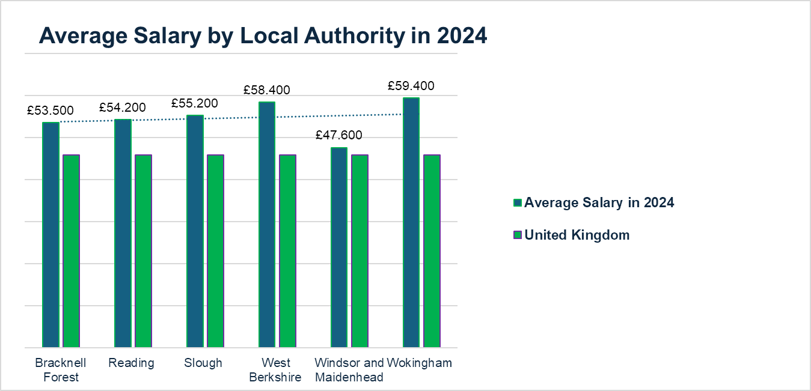
Wokingham is a salary leader in Berkshire
Key facts
The UK average salary was £45.8k in 2024.
The average salary ranges between £47.6k in Windsor and Maidenhead and £59.4k in Wokingham.
Wokingham has the highest average salary and Windsor and Maidenhead the lowest .
Source: ONS
Notes:
Wokingham Borough is a strategic location for businesses situated to the West of London in the centre of Berkshire at the heart of the Thames Valley.
The area is exceptionally well connected to both UK and overseas markets.
It sits between the M3 and the M4, and has excellent transport links to London and the wider Southeast by both rail and road and is in close proximity to the country’s major airports – Heathrow and Gatwick.
The strategic location has attracted major global technology, life science and more recently creative businesses such as Microsoft, Oracle, Hewlett Packard,
Bayer, Sanofi and Shinfield Studios as well as a plethora of small and medium enterprises including scale-ups.
Wokingham’s businesses are able to take advantage of the Borough’s strong and varied commercial space, good broadband and mobile connectivity.
The economic vision for the Borough is that by 2035, Wokingham Borough will have built ‘a growing and greener economy for everyone’.

Slide 5
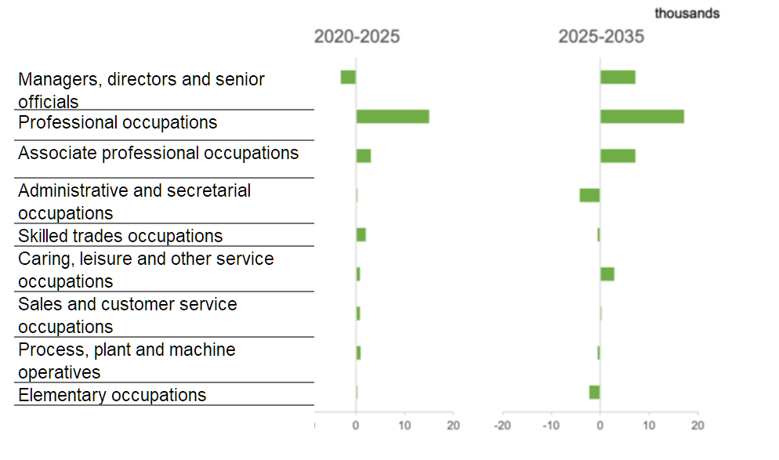
Professional occupations dominate the Job Market in Berkshire
Key facts
The most common occupation in Berkshire is ‘Professional’ (33%)
Followed by ‘Associate Professional’ (18%)
Then ‘Managers, Directors and Senior Officials’ (11%)
Source: EMSI
Notes:
For employment by occupation, in 2023, 60.1% of Berkshire’s workforce was at Manager, Director or Professional or Associate professional level, which was significantly higher than that for the South-East of 57.1% and 52.9% nationally.
Annex A pages 18 – 21 for more detail on this.

Slide 6
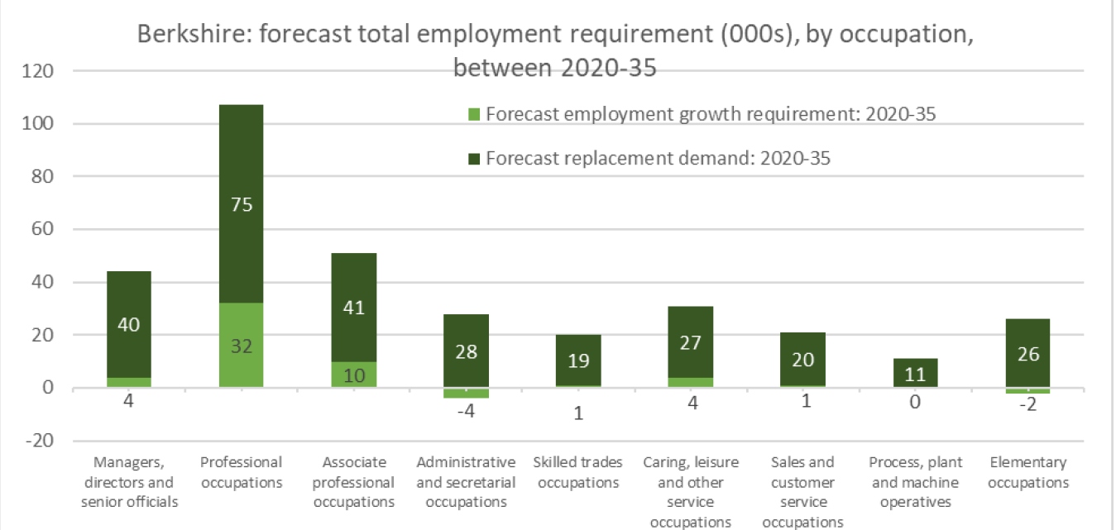
Employment forecast 2020-2035
Notes:
Showing gaps within relevant sectors either wanting extra employees or less employees required between now and 2035.

Slide 7
Opportunities in ...
Key Fact
For employment by occupation, in 2023, 60.1% of Berkshire’s workforce was at Manager, Director or Professional or Associate professional level
Notes:
There are some key occupational areas of consistent challenging and/or growing need shown here. These are consistent with the growing employee workforce numbers highlighted industries such as Professional, Scientific & Technical, Information & Communication and Care.

Slide 8
Number of jobs by occupation type in Berkshire compared with England
Notes:
Comparing the 25 sectors shown, Berkshire has a higher percentage rate in 9 areas of employment.
These are within, Science, Research, Engineering and Technology, Business and Public Service, Corporate Managers and Directors, Teaching and Educational Professionals, Skills metal, Electrical and Electronic Trades, Customer Service Occupations, Culture, Media and Sports Occupations.
This reflects the number of companies and job opportunities already discussed earlier.
The Berkshire Economic Strategy 2025-2035 is due to published with the aim for Berkshire to be UK's most productive and fastest-growing local economy by 2035.

Slide 9
Different types of work in Berkshire: Self-employment, SME’s, Part-time Working, Working from home & Portfolio Careers
Self-employment
13.2%
Of people working in Berkshire are self-employed. Self-employment is highest amongst those in skilled trades including construction roles and process, plant, and machine operatives.
Part-time Working
22.4%
of those in employment aged 16-64 work part-time.
SME’s
99.4%
of registered businesses in Berkshire are small or medium-sized enterprises.
41% of people were working primarily from home, compared to 32% across England
Portfolio Careers
More and more young people in Berkshire have a second job and enjoy flexible working, thereby suggesting portfolio careers are becoming popular.
Sources: ONS, NOMIS
Notes:
Other facts
Employment Characteristics (2022)
13.2% self-employed workers, broadly consistent with the national average.
3.7% (17,400) of people officially had two or more jobs
22.4% worked part-time
The pandemic had fundamentally changed where work is performed in Berkshire. As at March 2021, 41% were working primarily from home, compared to 32% across England.
Working from home has become the preferred work location for many of those who can. This impacts workers’ preparedness to travel to a fixed work location and increases work opportunities from outside the region from employers who are prepared to accommodate remote working.
The majority (62%) of the medium and large enterprises within Berkshire operate within five sectors: Information & Communication (a combined 170), Wholesale & Retail, & vehicle repair (140), Administration & Support Services (120), Education (115) and Professional, Scientific & Technical sectors (105).
More detail on Annex A
Page 17/18 and Page 25

Slide 10
(Numbers are rounded to the nearest 5)
Notes:
Here you can see the types of employers across Berkshire and the number of employees employed by them.
The average ‘all in employment’ figure for Berkshire across the year to September 2022 was 474,000.
Across the year to September 2022, the 474,000 people in employment in Berkshire were engaged in an average of 509,000 employee jobs.
Annex A page 17

Slide 11

Priority Sectors in Berkshire

Slide 12
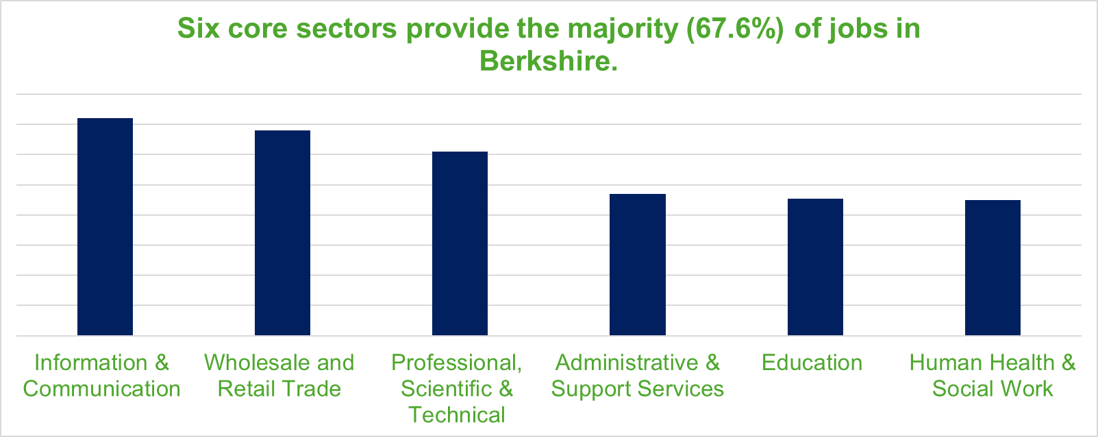
Priority Sectors
Key Fact
Top job postings in Berkshire are:
Professional, Scientific & Technical, Information & Communication and Care
Berkshire employment is highly dependent on the Information and Communication sector with 14.4% of the total jobs forecast in 2022 versus 4.7% in England
Notes:
There are six core sectors that provide the majority (67.6%) of jobs in Berkshire. These are: Information & Communication (14.4%), Wholesale and Retail Trade (13.6%), Professional, Scientific & Technical (12.2%), Administrative & Support Services (9.4%), Education (9.1%) and Human Health & Social Work (9.0%).

Slide 13

The Construction Sector
Key Fact
The biggest enterprise growth since 2017 has been in the number of companies involved in the construction of residential and non-residential buildings.
Notes:
Construction offers a wide range of careers, from designing and working on skyscrapers and bridges, to ensuring workers are safe on site and preserving heritage buildings.
Employers have reported growing demand and skills shortages. Despite this, the number of people in Berkshire engaged in skilled trades jobs has declined.
Forecast growth and replacement demand will add pressure to an employment market that is already tight.
In addition, changing technologies (often driven by the sustainability agenda) will drive further requirements for training and upskilling.

Slide 14

Life Sciences
Key Fact
Employers report chronic and acute difficulties in recruiting laboratory technicians and scientists
Images Vecteezy.
Notes:
In Life Sciences, there has been a growth in jobs over the last five years, particularly in the Wholesale of Pharmaceutical Goods, and the Manufacture of Pharmaceutical Products and Preparations.
A few of the companies in Berkshire are;
Becton Dickinson - Winnersh Triangle
Johnson and Johnson – Maidenhead
Bayer – Reading
RSSL – Reading
It does seem bazaar that even though we have many companies in the area they are still finding it difficult to recruit. A full list of Berkshire companies here UK - List of Biotech, Pharmaceutical & Life Sciences Companies for students to look through for employment.
Also, there are currently 993 NHS jobs found in Berkshire Jobs in Berkshire - NHS Jobs.

Slide 15

Care Sector
Key Fact
Adult care worker on average earns £20,536
Nursing home manager can earn £34,520
There are many more jobs such as Chefs, Grounds man and Drivers in this sector.
Notes:
An ageing population in Berkshire will drive demand for this industry.
The salaries might have a factor on the demand as they do not represent the responsibilities within the roles.
Adult care worker on average earns £20,536. With a low of £18,579 and high of £24,449
How much does a Nursing home manager make in Berkshire?
If we look at the Nursing home manager salary statistics in United Kingdom as of April 16, 2025, the represented employee makes £34,520; to be more precise pay rate is £2,877 per month, £664 per week, or £17.06 per hour.
The average salary for a Chef in Berkshire is £28,362. Chef in Berkshire salaries range from £22,999 to £32,499

Slide 16

The Screen Industries
Key Fact
There has been a substantial increase in the number of jobs in ‘Motion Picture, Video and TV Programme Production Activities in Berkshire
Images Vestees.
Notes:
“Berkshire is at the heart of Britain’s booming film and TV industry and is already home to world-class studios and crew.
There has been major investment in the UK’s film and high-end TV (HETV) production in the past few years this is set to grow in significant new and replacement demand for the foreseeable future.
An organisation formed to provide opportunities for work and training in Berkshire's booming film industry has been launched.
Screen Berkshire will support the ongoing growth of the film and TV production industry in the region.
Shinfield Studios is a Screen Berkshire partner alongside the University of Reading and Berkshire-based Bedlam Film Productions. The organisations were brought together and are led by Slough-based social enterprise Resource Productions CIC, which also established the Berkshire Film Office, with all six local councils.
“Screen Berkshire is focused on providing opportunities for Berkshire people of all backgrounds to train or update their skills, to help match the continued high demand for skilled crew. A more diverse production staff, and a broader pipeline of technical and creative talent, is crucial to the future of the industry. Through Screen Berkshire, we have the plan and the partners to achieve it.”

Slide 17

Haulage & Logistics
Key Fact
Skills requirements are heavily influenced by changing technology and automation.
Freight Drivers, Vehicle Mechanics, and Warehouse Workers- remain in high need
Notes:
The shortage is due to 55% of the current HGV workforce being aged between 50 and 65, the country is on the cusp of a mass retirement wave that could leave a critical gap in the logistics sector.
Young people face some challenges (in terms of licence eligibility) and the industry faces image challenges when it comes to becoming HGV drivers. Many may have chosen other career paths before they’re even eligible to begin training for a commercial driving licence.
“Professional driving can offer great flexibility, decent wages, the chance to travel and meet people — we need to promote this narrative far and wide, ideally before career choices are locked in.”

Slide 18

ICT
Key Fact
Berkshire is significantly dependent on the Information and Communication sector with 14.4% of jobs in this sector in 2022 compared to 4.7% across England.
Notes:
Demand within the Information & Communication industry across Berkshire is forecast to continue to increase in size and will require an additional 13,800 workers by 2035
Berkshire’s economy is critically dependent on the ICT sector which generates nearly a quarter of its GDP. It is vital that the skills needs are met to enable businesses to remain competitive.
Workforce has continued to grow, particularly in graphic and web design and computer programming and software development.
The forecast growth and significant replacement demand is for 48k jobs up to 2035
Many apprenticeships are on offer to bridge the recruitment difficulty.

Slide 19
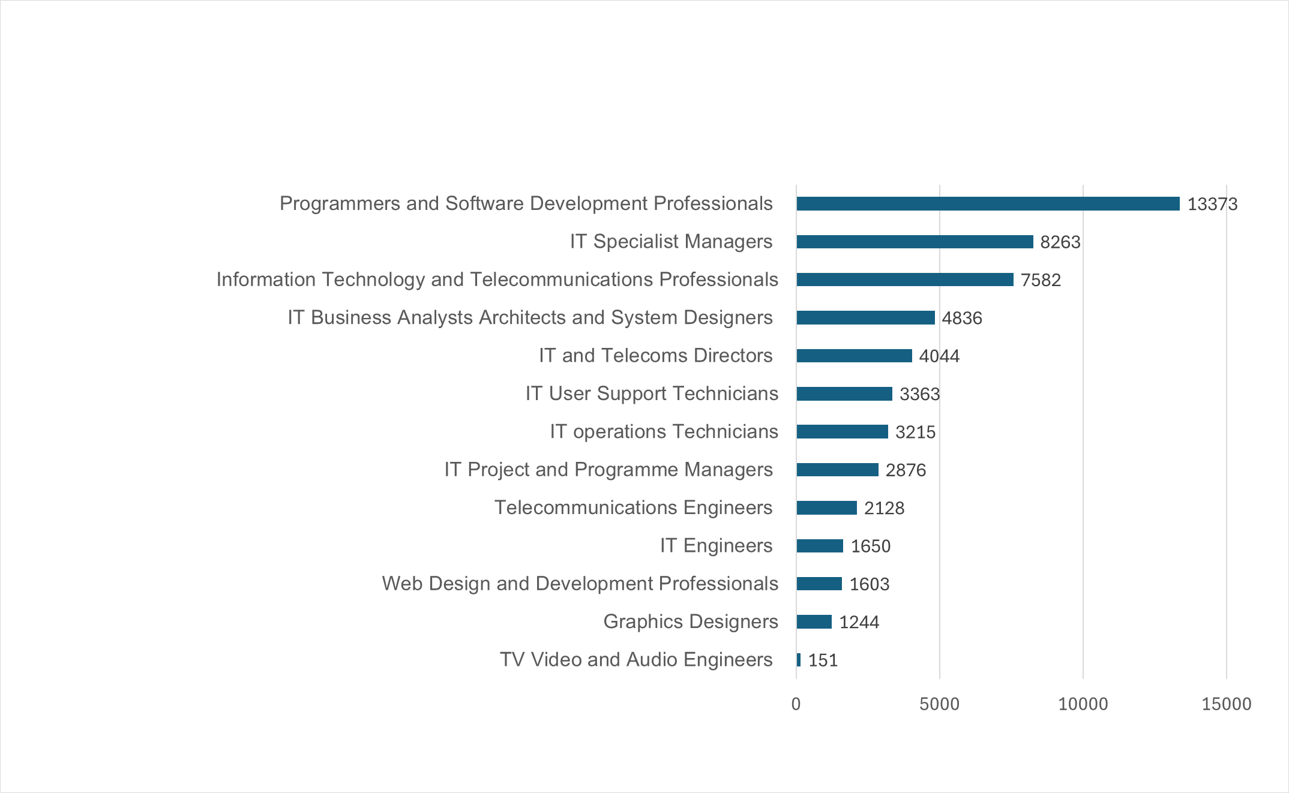
Workforce jobs in Berkshire in the Information and Communication sectors 2022
Source: EMSI
Notes:
There are 72,320 digital jobs in Berkshire today, representing 14% of all jobs in the county. Demand for these jobs has remained strong in recent years, with job vacancy volume recovering quickly after a minor dip during the first Covid-19 lockdown
Invest 2035: the UK's modern industrial strategy
Updated 24 November 2024 Invest 2035: the UK's modern industrial strategy - GOV.UK

Slide 20
Study Levels and Apprenticeships

Slide 21
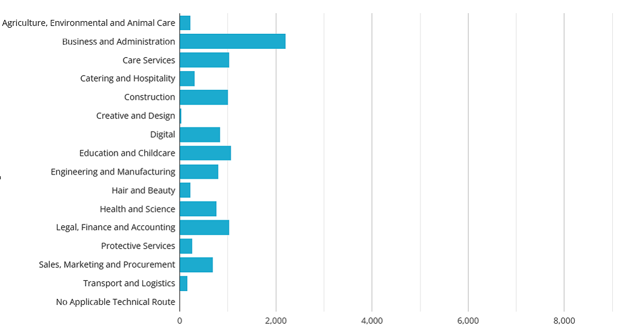
Technical Routes
Number of Apprenticeships
Notes:
There was a broad range of apprenticeships across the technical routes, the largest volumes were in Business and Administration with 2,210 apprentices on a programme.
The volume of apprenticeships in the routes aligned to some priority sectors (Screen Industry and Haulage & Logistics) were relatively small.
Page 29 Annex A

Slide 22
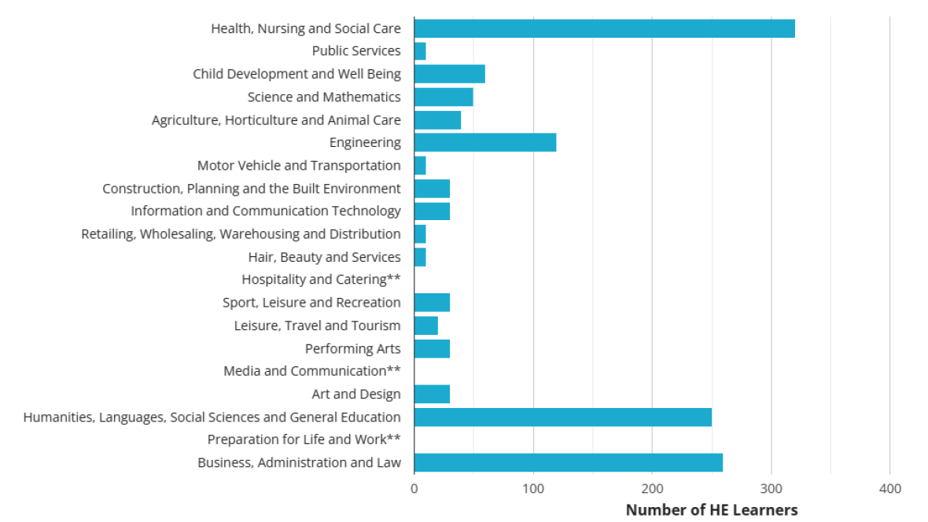
Higher levels of Study at Levels 4 and 5
Notes:
In 2020/21, 1,460 learners studied at Levels 4 or 5 in Berkshire.
Of these, the largest volumes of enrolments were in Health, Nursing & Care. There were relatively few enrolments in qualifications addressing priority sectors such as Science, Construction, ICT, Media.

Slide 23
Jobs that require level 4 qualifications include:
Junior Business Analyst
Engineering Technician
Computer Network Support
Assistant Manager
Graphic Designer
Laboratory Technician
Healthcare Practitioner
Marketing Associate
Teaching Assistant
Human Resources Coordinator

Slide 24
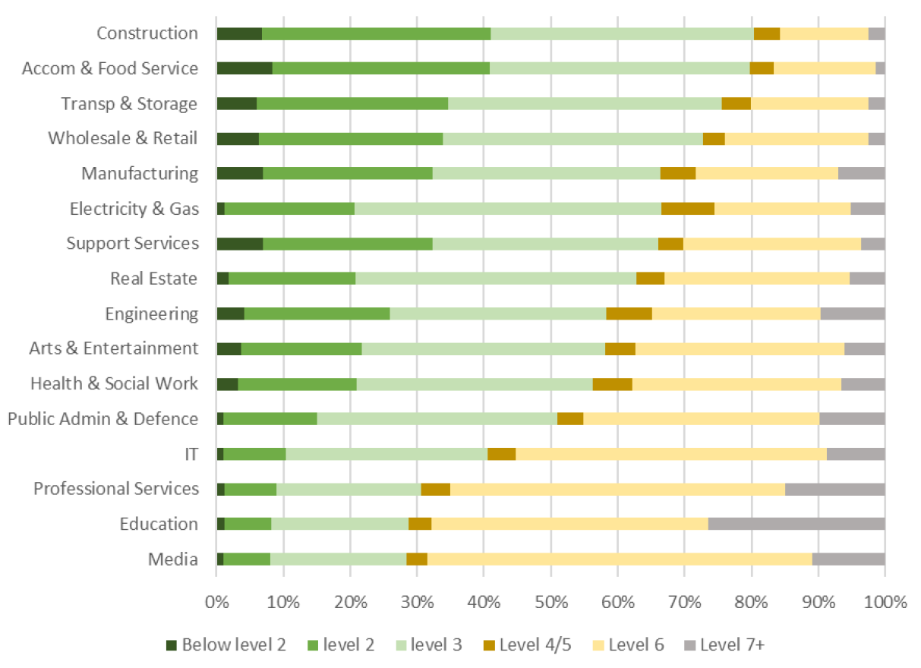
Southeast Highest Attainment Level by Industry (employees aged 25-30)

Slide 25
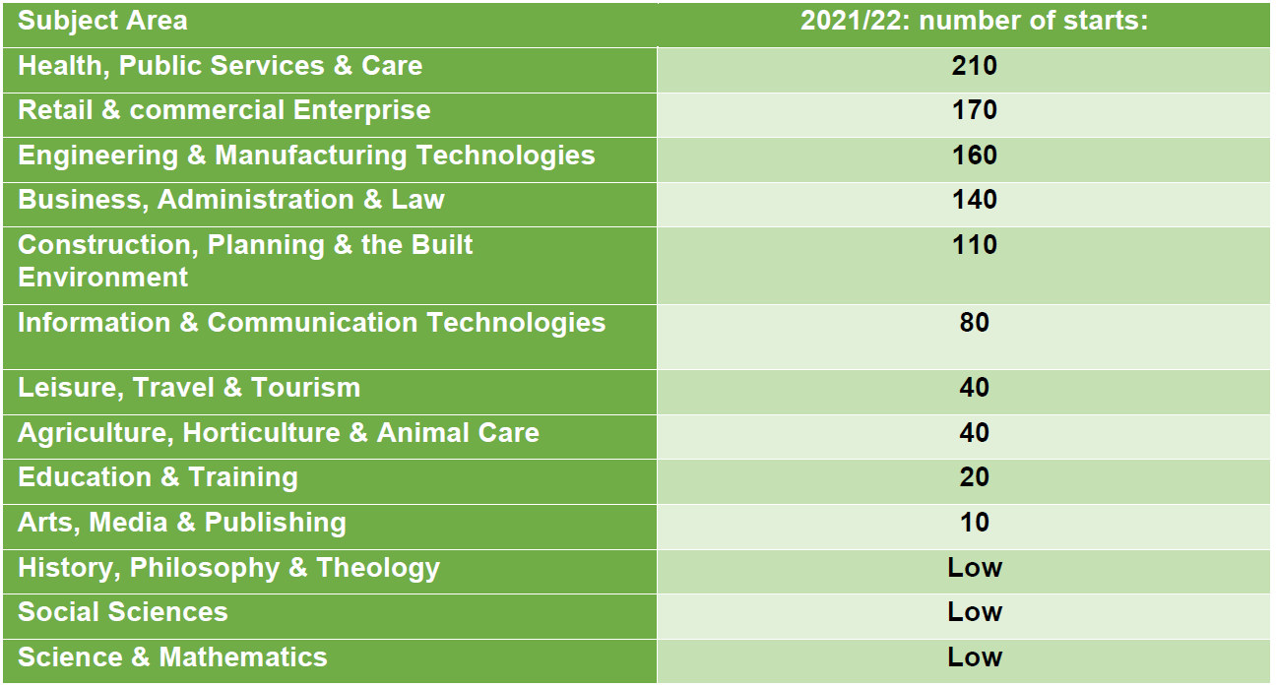
Apprenticeship Subject Starts in Berkshire
Source: DfE Apprenticeships & Traineeships
Notes:
Amongst Apprentices aged under 19, five key subject areas represented 81% of the 980 identifiable Starts in 2021/22. Of the priority sectors, apprenticeship volumes were lower in Media (Screen Sector), Science (Life Science) and ICT.

Slide 26
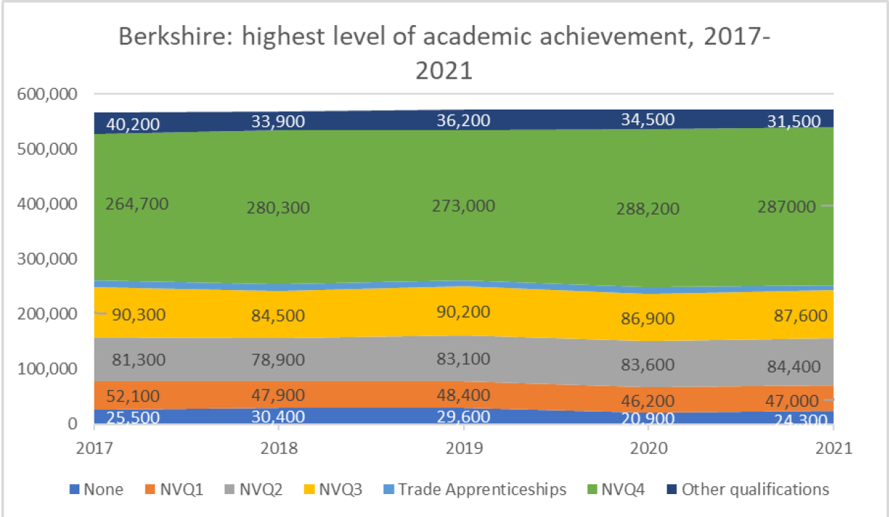
A Highly Educated Berkshire: 50% Attain Level 4 qualifications or above
Key facts
A significant portion of Berkshire's population 50%, possesses Level 4 qualifications or higher.
This is higher than the national average of 44%
Sources: EMSI, ONS
Notes:
Half (50%) of residents aged 16-64 in Berkshire were, by 2021, educated to level NVQ4 or above – up from 39% a decade earlier.
No qualifications: no formal qualifications
Level 1: one to four GCSE passes (grade A* to C or grade 4 and above) and any other GCSEs at other grades, or equivalent qualifications
Level 2: five or more GCSE passes (grade A* to C or grade 4 and above) or equivalent qualifications apprenticeships
Level 3: two or more A Levels or equivalent qualifications
Level 4 or above: Higher National Certificate, Higher National Diploma, Bachelor's degree, or post-graduate qualifications

Slide 27
KEY SKILLS

Slide 28


The main common skills Berkshire employers are looking for​
Key facts
The skill with the highest number of job postings is Communications, with 68,096 postings.
Management skills are the second most sought after with 49,954 postings, followed by Customer Service at 39,292 postings.

Slide 29

The main specialised skills Berkshire employers are looking for​
Key facts
Agile Methodology (9,828 postings) and JavaScript (5,328 postings) lead in demand within the technology sector.
Business and Financial Expertise: Finance (15,313 postings) and Accounting (10,494 postings) are skills with the highest number of job postings.
Notes:
A shortage of finance skills and marketing, particularly digital marketing is cited in the LSIP findings and reports

Slide 30

Key facts
27% of Berkshire employers who recruit school leavers believe they are poorly prepared for work.
Of these, 12% say they believe young people have a poor attitude / lack motivation. So whilst most don’t think this, a fair chunk do.
The main employability skills Berkshire employers are looking for​

Slide 31
Ten ideal skills for a successful career
Technology use, monitoring and control
Technology design and programming
Analytical thinking and innovation
Active learning and learning strategies
Complex problem solving
Critical thinking and analysis
Creativity, originality and initiative
Leadership and social influence
Reasoning, problem solving and ideation
Resilience, stress tolerance and flexibility
Key facts
The world of work is changing. As we enter the Fourth Industrial Revolution, developments in fields such as robotics, AI,
nanotechnology and
autonomous vehicles, look set to change the way we live and work.
Across all sectors of the economy some roles will disappear and more will evolve.
Source: World Economic Forum

Slide 32
Jobs local employers find difficult to fill
Key facts
Job positions that employers in Berkshire find most difficult to fill include engineers; social workers; chefs; waiting and bar staff; software developers; lorry drivers; health workers; teachers and Apprentices.
“We are short of website coders; RPA project managers/coders; sales order processors; customer service agents; international shipping advisers; and warehouse operatives”
 | - Logistics and Warehousing Company
“We use about 100 different standards across the NHS. 97 specific occupations are in the H&S route. There are 350 careers in the NHS and there is an apprenticeship pathways for nearly everyone”
- | - Learning & Development Manager, Frimley Health NHS Foundation Trust
Reading and Thames Valley has a requirement for sales and marketing professionals in the Tech Sector, to enhance engineering and software development hubs, which can be located overseas. Tech sales professionals are welcomed at all levels, from SDR entry level, Account Management, advanced Solutions Engineering roles and Customer Success positions supporting clients post sale. - EMEA sales and marketing Egnyte Reading
“Currently the UK has 67,300 Information Security professionals, which grew by almost 10% in last year. This trend is expected to continue and require many more professionals to keep pace with the technology trend.”
 | Cyber Security Manager
Notes:
Forecast business growth is likely to require more skilled labour, at a time when there is a tightening labour market with skills shortages and increased competition for workers in certain industries. For production to remain competitive many businesses are dependent on greater automation and the use of new technologies and a highly skilled IT workforce.
Many of the dominant sectors in Berkshire (particularly Professional, Scientific & Technical Activities, Information & Communication) are changing through digitalisation and new technologies and have increasing demands for skills
Difficulties can be found in the priority sectors of Health, Construction and Haulage and Logistics.
Because of the predominance of SMEs, employer demand can be fragmented
All the key LSIP recruitment difficulties/skills shortages can be found in the report, pages 16 – 22
Berkshire Local Skills Improvement Plan (berkshirelsip.co.uk)
There will be an update to this to be published by the end of June.

Slide 33
Next Steps for Careers Leaders
Next Steps
Increase collaboration with businesses
Understand local skills shortages
Promote priority job families, apprenticeships and trainee opportunities
Increase collaboration with local businesses of all sizes to highlight skills and promote the benefits of work experience (including virtual schemes)
Promote opportunities in the top priority sectors: Screen Industries, Construction and the Built Environment, Health and Life Sciences, Care, Haulage & Logistics, ICT
Promote apprenticeships, technical education and pathways.
Share the most common specialist skills gaps in Digital Technology, Engineering, Marketing, Customer Service and Analytics
Share the most wanted common skills of Communication, Good Work Ethic, Time keeping and problem solving skills.

Slide 34





www.berkshireopportunities.co.uk
More Information
Gateway to explore jobs, apprenticeships, and courses in Berkshire
Key information available for a wide range of jobs
Berkshire Careers Guide

Slide 35
Further
Resources
Amazing Apprenticeships - www.amazingapprenticeships.com/apprenticeship-pack/
Apprenticeship vacancies and information online
  www.apprenticeships.gov.uk
  www.ucas.com/apprenticeships
Berkshire Opportunities - www.berkshireopportunities.co.uk
Berkshire Local Skills Improvement Plan Berkshire LSIP Report - Annex A
National Careers Service - nationalcareersservice.direct.gov.uk
Organisation for Economic Co-operation and Development (OECD) www.oecd.org/en/publications/
Plumplot area insights and income www.plumplot.co.uk/
The Careers and Enterprise Company - www.careersandenterprise.co.uk
The Cyber Security Sectoral Analysis 2025
The Skills and Business Hub -www.thamesvalleyberkshire.co.uk

