Slide 1
Year 13
Prepare to succeed
September 2022
Notes:
PG

Slide 2
Welcome!
Welcome back to all parents and carers and welcome to the Year 13 Success in the Sixth Form Information Event.
We hope you had a restful summer break.
Notes:
PG

Slide 3
Results

Slide 4
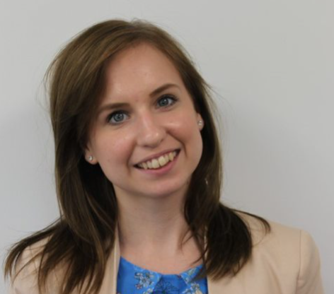
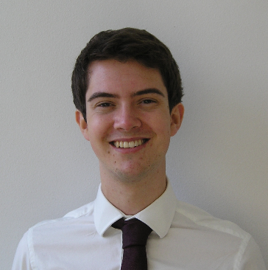
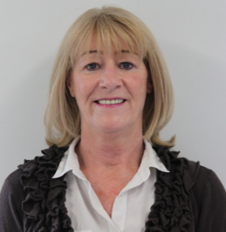
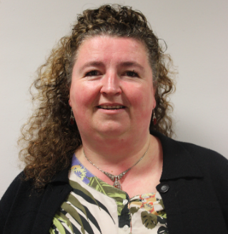
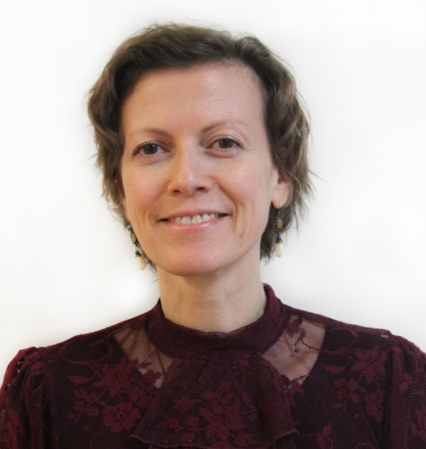
Introducing the Sixth Form team
Mr Ging
Head of Sixth Form
Miss Inwood
Assistant Head of Sixth Form
(Year 12)
Mr Colmer
Assistant Head of Sixth Form
(Year 13)
Mrs Pasa
Sixth Form Manager
Mrs Wilson
Sixth Form Administrator
Ms Bouzid
Sixth Form Learning Mentor
Notes:
PG

Slide 5
Outline of this presentation
This presentation is designed to give you important information on how to help your child:
Make a successful transition from Year 12 to Year 13
Meet the expectations of Year 13
Key information for this year
Notes:
PG

Slide 6
Year 12 to Year 13 Progression
(Thinking about exams)
Notes:
ATC
Things that you may find useful

Slide 7
Moving into Year 13
Sixth Formers often find the move into Year 13 a point of transition that is similar to the movement into Year 12 in that there are some developments for students:
Increased workload
Greater focus on examination
More attention being given to post-Sixth Form destinations
Notes:
ATC

Slide 8
Increased workload
Students may find that teachers are setting more work due to:
Covering course content remaining in students’ qualifications
Revising content covered last year
Engaging students in broadening their knowledge (wider reading, research etc)
Deepening students’ knowledge and enhancing their proficiency in assessment context (past papers, practice essays etc)
Notes:
ATC
Not necessarily finishing by March – could be teaching up to the end

Slide 9
Greater focus on examination
Students have had PPEs in June of year 12
Students are scheduled to have Y13 PPEs between the 16th and the 20th January 2023
Students may find there are additional in-class tests in order to prepare and familiarise them with exam-style assessment throughout this year
Notes:
ATC

Slide 10
Greater focus on examination
The purpose of PPEs for students are:
Effective preparation for assessments under exam conditions
Developing familiarity with examinations and reducing exam anxiety
To develop effective examination technique
The purpose of PPEs for teachers are:
To assess the achievement levels of their students
To inform planning for progression and to allow teachers to target specific areas for development in students
Notes:
ATC

Slide 11
Year 12 to Year 13 Progression
(Thinking about destinations)
Notes:
PG

Slide 12
UCAS Personal Statements
Students have been encouraged to work on their personal statements since June
Students were given the advice to submit their personal statement drafts by the first day back
All students were advised to write a personal statement regardless of destination due to:
Some students changing their mind about higher education
The transferable nature of a personal statement
Statements need to be uploaded to unifrog, the school’s online platform for destination guidance and tracking
Notes:
PG

Slide 13
The UCAS process 2023
Security marking: PUBLIC
09 September 2022
| 13
Notes:
PMG
- Talk parents through stage of the process

Slide 14
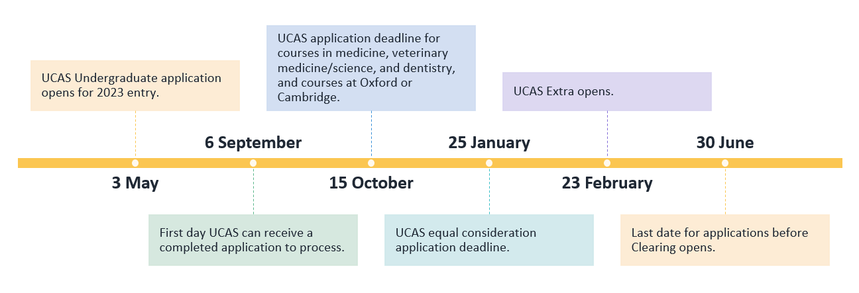
The UCAS timeline 2023
Security marking: PUBLIC
09 September 2022
| 14
Notes:
PMG
- How parents can help (active engagement with course searches, visiting on open days – either virtual or in person – being aware of deadlines, pay and send, send of meetings – the triple check)

Slide 15
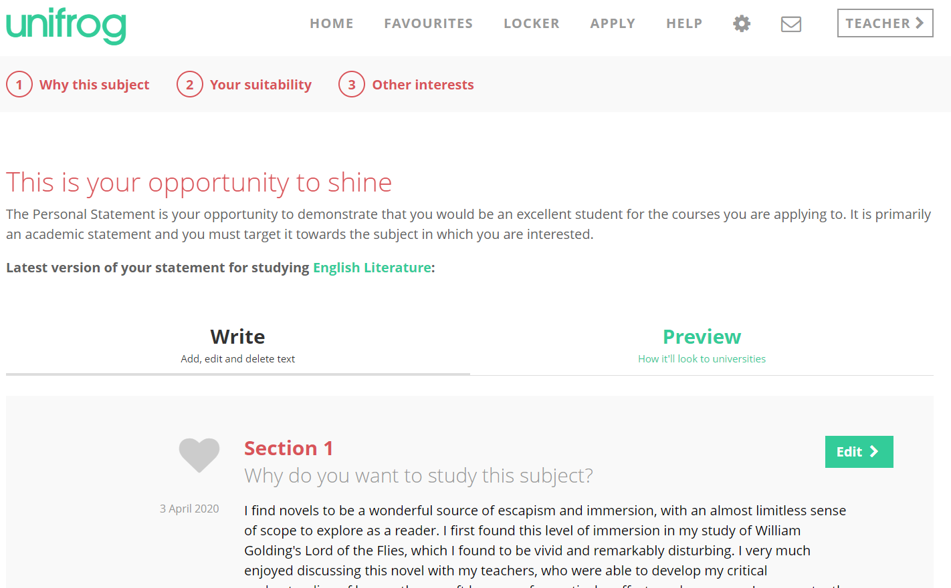
Unifrog and the Personal Statement
Notes:
ATC
Parents can see these as students can log in anywhere – share with your children!

Slide 16
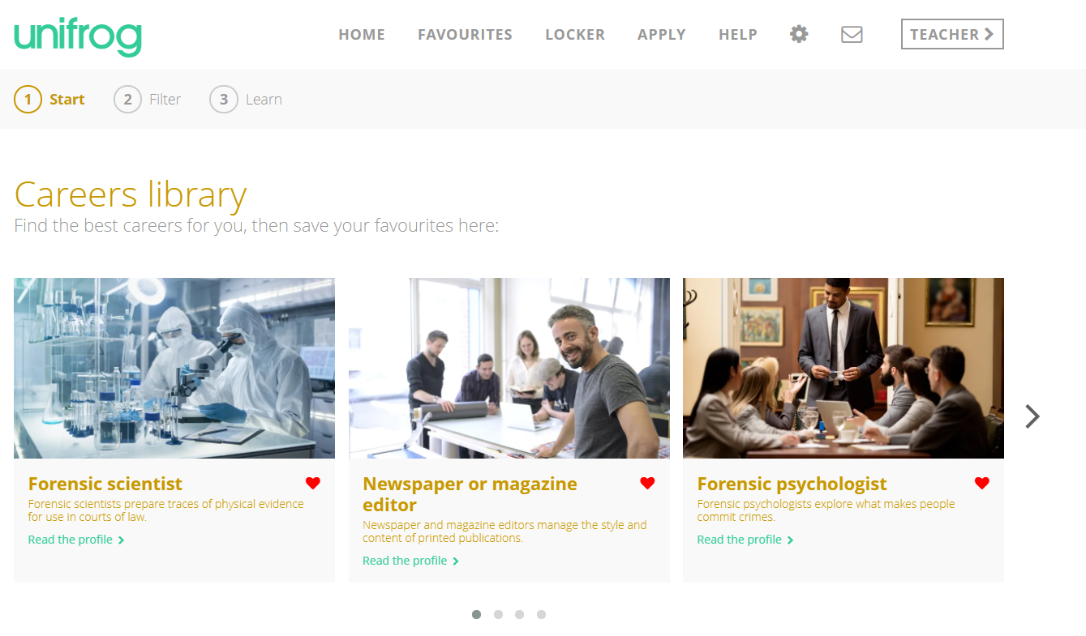
Unifrog support for Uni and non-Uni
Notes:
ATC

Slide 17
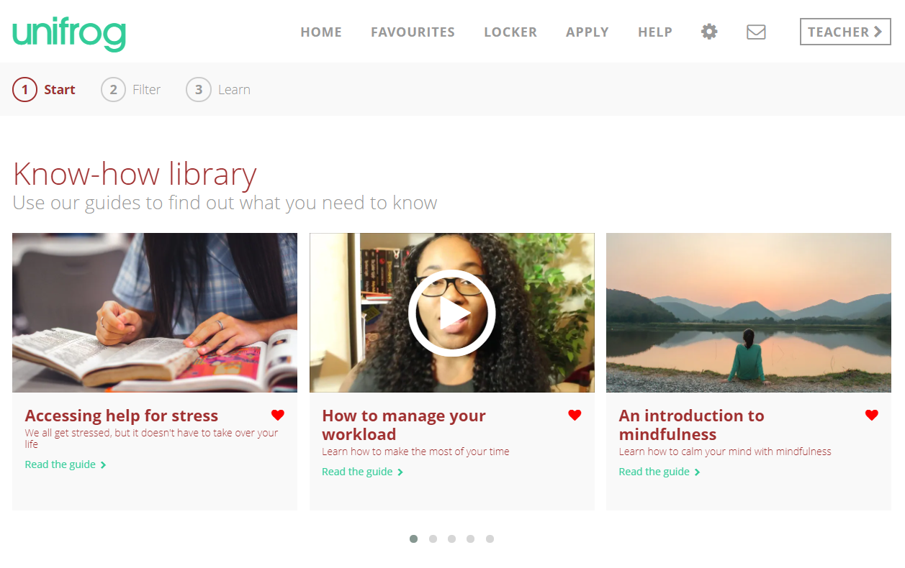
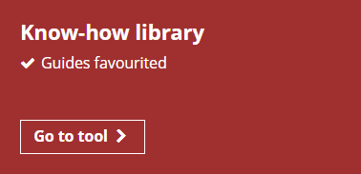
Unifrog support for Uni and non-Uni
Notes:
ATC

Slide 18
Alternatives to university research
Students who are not thinking about university should be engaging in alternative research: apprenticeship, gap year, employment, internships or sponsored degrees
Students have been encouraged to develop shortlists on unifrog and use tools such as the Amazing Apprenticeships website and the gov.uk search tool
Students should be mindful of the fact that apprenticeships do not have a single deadline as UCAS does and that each apprenticeship is unique
Notes:
PG
Run through each resource and explain these graphics are hyperlinked

Slide 19
Gap Years
There are various companies that offer gap years of varying lengths, from whole year programs to 3 – 6 week programs.
Gap years can be charitable or conservation-based in nature, or can look to develop specific skills in areas of potential careers such as Business or the Arts.
Notes:
PG
Hyperlinks are live

Slide 20
Year 12 to Year 13 Progression
(General Tips!)
Notes:
ATC

Slide 21
Student Do’s and Don’ts for effective Y13 Transition
DO utilise free time for study, revision and further reading.
DO manage your time: set and keep to deadlines is top of priorities, plan your weeks carefully.
DO keep a mature manner around Sixth Form, building relationships with Sixth Form staff as they play important roles as UCAS referees.
DO talk to your parents/people at home. Big part of doing well is knowing there’s a support network around you – use it!
DO remember that you will get to where you want to be. A positive mind set is key. Just realise that it’s a lot of work and it’s on you to go get it.
Notes:
ATC

Slide 22
Independent Study
Students have, on average, 27 hours of lessons per fortnight cycle.
We expect students to match this time commitment with independent study, revision and consolidation.
We give time to students to achieve this in school through:
Supervised Study periods (6 per fortnight)
Independent Study periods (14 per fortnight)
This leaves students around 7 hours per fortnight or 3.5 hours of work to complete at home/in their own time each week.
If students manage their time and use their school time effectively for study, they will protect their work-life balance comfortably.
Notes:
PG
Stress that may of our students last year did very well but there were some bitterly disappointed and in most cases, this was as a result of not employing their time best.

Slide 23
Do’s and Don’ts
DON’T catastrophize. The worst thing can always be avoided with help.
DON’T avoid things. If there’s an issue, ‘burying your head in the sand’ will only make things worse.
DON’T wait to complete your personal statement – this is not as big a job as it might seem and you will feel much better once its done.
Notes:
ATC

Slide 24
Year 13 Expectations
Notes:
PG
Reminder for students and to give parents an understanding of how we are helping support student NOT do some of the Don’ts on the last slide!

Slide 25
Expectations
Generally, the expectations of Year 13 do not differ from those in Year 12
Students are still expected to meet the terms of the Sixth Form Student Charter, Sixth Form Uniformand Sixth Form Attendance Policy
For ease of reference, these are included over the following slides
Notes:
PG

Slide 26
How do students meet expectations in the Sixth Form? - The Sixth Form Charter
Attend all lessons punctually and have an ACHIEVE growth mind-set
Commit to being an outstanding learner. Give 100%, 100% of the time
Effectively manage relationships in a mature, respectful and intelligent manner
Demonstrate a proactive approach, accepting responsibility for your own learning
Contributing meaningfully to the Sixth Form Community and being proactive in the wider life of our Sixth Form
Consistently maintain a positive attitude to learning grade Good or better (1 or 2) for all my subjects
To dress smartly, meeting the Sixth Form Uniform
To always wear your student ID badge
Respect and look after the Sixth Form block
Take personal responsibility to regularly check school emails.
Attend all compulsory visits and events scheduled in the Sixth Form.
Notes:
PG

Slide 27
Attendance and Punctuality
The school day starts with tutor time at 8:45 for Year 12 and 13 students. Students are expected on site by 8:40. We recommend 8.30!
Students will be expected to attend all formal registered timetabled lessons, including:
Tutor time
Supervised study
REC
All subject lessons
Subject clinics
Students will need to sign in and out if they leave school site. If they are feeling poorly they need to see Mrs Pasa.
Notes:
ATC – e.g. sciences have mandatory attendance at times for clinics.

Slide 28
Attendance and Punctuality
Student attendance and punctuality to lessons is monitored in the usual way
96% is the our minimum expectation for Sixth Form attendance, although students should aim for 100%.
In context:
96% = 8 school days missed per year
90% = 19 school days missed per year
A student that is 30m late each week will lose the equivalent to 19 days per year
Statistically, missing just 17 days per year is likely to mean a drop for students of 1 grade across their subjects
Notes:
ATC

Slide 29
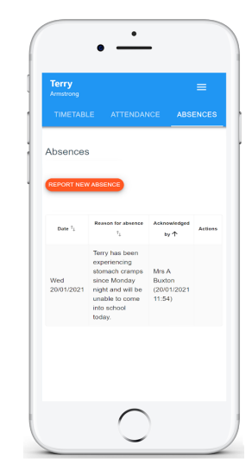
Expectations - Attendance
If your child is going to be absent please notify us as quickly as possible using your Class Charts sign in.
Selecting the Absences tab will display a list of absences that you have reported, once you have reported them.
This includes when the absence took place, the reason for the absence and who acknowledged your absence report.
To report an absence, click on the Report new absence button.
Notes:
KLI

Slide 30
The importance of tutor time
Tutors will be working closely with their tutees and will be meet regularly during tutor time regarding:
General messages
Careers and Futures Guidance
Academic guidance and Study Skills support
Pastoral support and wider personal development
Tutors should be the first port of call for students and parents and carers for any questions, queries or concerns. Their email addresses are on the following slide
Notes:
PG – tutors have changed due to staff movement but also due to the Sixth Form team returning to Year 12 and 13 only in SF tutor groups. This gives us an opportunity to balance numbers in each tutor group so every student gets equal attention in this important year.

Slide 31
Tutor contact
Form tutor | Email address | Form tutor | Email address
Ms Threlfall | Caroline.Threlfall@furzeplatt.net | Dr Wyatt | Marina.Wyatt@furzeplatt.net
Mr Bahra | Gurjeet.Bahra@furzeplatt.net | Mrs Budgett | Alice.Budgett@furzeplatt.net
Mr Green | Thomas.Green@furzeplatt.net | Mrs Hawkins | Lynn.Hawkins@furzeplatt.net
Mrs Byrne | Vinita.Byrne@furzeplatt.net | Mr Jones | Chris.Jones@furzeplatt.net
Mr Forster/Mrs Owen | Sue.Owen@furzeplatt.net Stuart.Forster@furzeplatt.net | Dr Walker/Miss Griffiths | Catherine.Walker@furzeplatt.net Lois.Griffiths@furzeplatt.net
Mrs Jack | Deborah.Jack@furzeplatt.net | Mr Green-Nickel | Fred.Green-Nickel@furzeplatt.net
Notes:
PG

Slide 32
Tutor support/online resources
Tutors will be in touch with students regularly with helpful resources and support tips to help with:
University and apprenticeship application.
Careers guidance
Learning support
Revision assistance
Seminar material
Notes:
ATC

Slide 33
How can students best support their academic study?
Download the specifications for all your subjects
Regularly evaluate your learning by using a Personalised Learning Checklist (PLC)
Download exam questions & mark schemes
Read ahead – use the wider reading lists on the website!
Read and condense your notes – keep this strategy active using the Cornell method distributed last term
Practice answering past exam questions
Research specific topics/areas of study in greater depth using the internet
Manage time well by planning when, where, what and how revision will occur
Notes:
PG

Slide 34
How can parents best support their children?
Being a role model
Help them set goals
Keep them active
Healthy eating
Time out
Sleep patterns
Unplugging
Staying cool & calm
Belief
Be supportive
Each day you can support your child to make choices which can impact how they perform during the next two years
Notes:
PG
Focus on points 2, 5, 6, 7

Slide 35
Some final bits and pieces…
Notes:
PG

Slide 36
Measuring Progress
3 Achievement & Effort grade Reports:
Oct
Dec
Feb
These can be accessed via Go4Schools, which can be found here.
Notes:
ATC
Encourage parents to login and access these

Slide 37
The 16-19 Bursary
The 16 to 19 Bursary Fund is a government provided, means-tested fund, providing financial support to help students to overcome specific barriers to participation so they can remain in education and training.
There are two types of Bursary details of which can be found under the Bursary section of the Sixth Form handbook on our website: FPSS Sixth Form Handbook
Notes:
PG

Slide 38
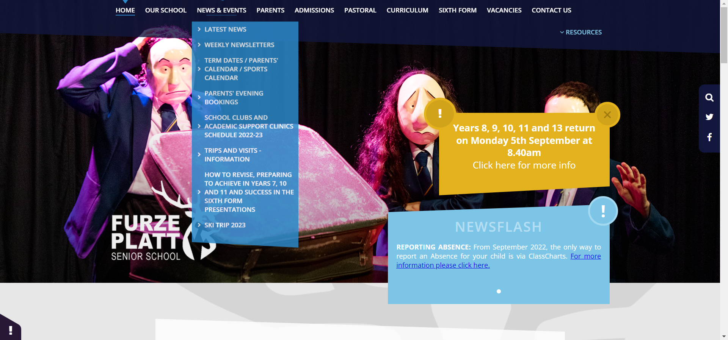
Useful Information
Course guides, student hand book, UCAS & higher education, Key dates, the charter, tutor time
Notes:
PG

Slide 39
Parental clinics
Mr Ging and I will be available to meet with parents each Wednesday afternoon between 3.30pm and 4.30pm
We will be offering 10-minute appointments over the first half term for parents to drop in and ask any questions they may have
If you would like an appointment time, please email sixthform.admin@furzeplatt.net and we will respond with a 10 minute time slot for a Wednesday afternoon
Notes:
ATC

Slide 40
Thank you for listening!
Thank you for listening and we hope this has been informative for you
Should you have any further questions, do contact your child’s form tutor and they will be only too happy to help
All that remains is for us to say how much we are looking forward to supporting your child through their final year in Furze Platt!
Notes:
PG + ATC

