Slide 1
Year 12
Prepare to succeed
September 2022

Slide 2
Welcome!
Welcome back to all parents and carers of previous Furze Platt students.
An extra special welcome to students and parents new to Furze Platt.
Welcome to the Year 12 Success in the Sixth Form Information Event.
Notes:
PG

Slide 3
Results

Slide 4
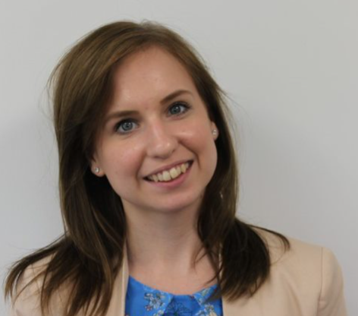
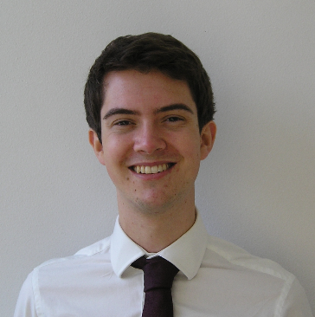
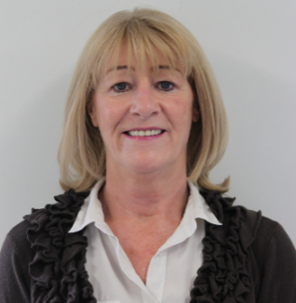
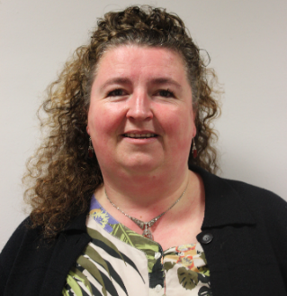
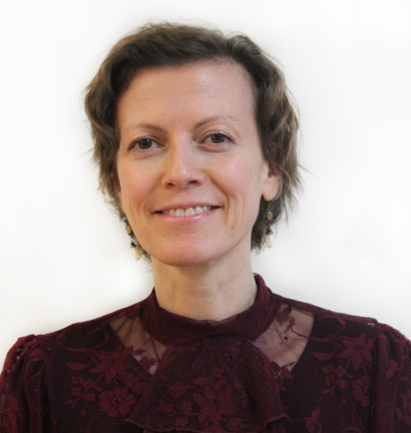
Introducing the Sixth Form team
Mr Ging
Head of Sixth Form
Miss Inwood
Assistant Head of Sixth Form
(Year 12)
Mr Colmer
Assistant Head of Sixth Form
(Year 13)
Mrs Pasa
Sixth Form Manager
Mrs Wilson
Sixth Form Administrator
Ms Bouzid
Sixth Form Learning Mentor
Notes:
PG

Slide 5
Outline of this presentation
This presentation is designed to give you important information on how to help your child:
Make a successful transition from GCSE to A-Level/BTEC
Meet the expectations of Sixth Form?
As well as information on:
Top tips for supporting your child
Notes:
KLI

Slide 6
The three-way partnership
Notes:
PG

Slide 7
Making a successful transition to Sixth Form (tips from previous students!)
Independence and proactivity
Organisation and time management
Effective recording of learning and in note making
Resilience and grit
Genuine academic engagement – wider reading and research. Depth over breadth.
Beyond Sixth Form - extra curricular activities
Work-Life balance: getting this right
Understanding your grades (and using them!)
Notes:
KLI

Slide 8
Student tips for Wellbeing
'Have a positive attitude’ – set your goals
Sleep
Exercise
Talk – to friends, parents, teachers
Seek help when you need it
Give back to the Sixth Form and the school – doing things for others is a proven wellbeing trick
All of this will help reduce stress, helping you stay as calm as possible
Notes:
PG

Slide 9
Student Do’s and Don’ts
DO utilise non-contact time for study (being proactive if no work to be worked on, not just chilling all the time, further reading).
DO manage your time: not working too much, for those that do work - keeping to deadlines is top of priorities, good amounts of time spent doing the right things such as sleeping, socializing - not being stressed about time due to working.
DO keep a mature manner around Sixth Form, building relationships with Sixth Form staff as they play important roles as UCAS referees.
DO talk to your parents/people at home. Big part of doing well is knowing there’s a support network around you – use it!
DO remember that you will get to where you want to be. A positive mind set is key. Just realise that it’s a lot of work and it’s on you to go get it.
Notes:
KLI

Slide 10
Do’s and Don’ts
DON’T catastrophize. The worst thing can always be avoided with help.
DON’T avoid things. If there’s an issue, ‘burying your head in the sand’ will only make things worse.
DON’T wait. Tackle things early. Your plans for after Sixth Form? Start making them now…it’ll make the end of your year (and Year 13!) much more straightforward and less stressful.
Notes:
PG

Slide 11
ACHIEVE
Notes:
KLI

Slide 12
Being Ambitious
Having high standards and high expectations.
Seeing learning and personal growth as important attributes for life.
Having clear aspirations for further education, university study and successful careers.
Possessing intrinsic enthusiasm and desire to achieve your personal best.
A desire to motivate others to excel.
Seeing opportunity for personal development both in the classroom and through wider learning opportunities.
Notes:
PG

Slide 13
Actively seeking to be the strongest role models for younger students.
Considering personal behaviour as an opportunity to create a lasting legacy for the school.
Actively supporting each other in achieving academic success.
Actively contributing to a community that is purpose-built for you.
Taking opportunities for leadership.
Being collaborative
Notes:
KLI

Slide 14
My favourite!
Pride – tell us what’s going well!
A genuine desire to celebrate success in ourselves and each other.
Seizing opportunity.
Being optimistic about the future and approaching challenge with grit and positivity.
Sharing cake.
Being Happy
Notes:
PG

Slide 15
Possibly the hardest one…
Putting your money where your mouth is. Doing what you say and plan to do.
Being honest with yourself and each other. Holding yourself to account.
Being trustworthy and living up to the role model of a FPSS Sixth Former.
Altruism and compassion.
Having integrity
Notes:
KLI

Slide 16
Understanding that A-Levels will be difficult and not letting that knowledge daunt you.
Taking criticism constructively. Seeing failure as part of learning.
Managing a healthy lifestyle and work-life balance.
Learning when to lean on others and ask for help.
Having Endurance
Notes:
PG

Slide 17
Adapting your learning approach to best suit subjects, modules, tasks.
Showing initiative and having the ability to learn independently as well as when being taught.
Being prepared to re-consider opinions, options and ideas.
Adapting your interpersonal approach depending on various situations.
Having versatility
Notes:
KLI

Slide 18
All of which lead to Excellence
Outstanding A-level results!
But also…
University
Apprenticeship
Employment
Being in the right place, doing the right thing…and being happy.
Notes:
PG

Slide 19
Our expectations
Notes:
PG
Things that you may find useful

Slide 20
How do students meet expectations in the Sixth Form? - The Sixth Form Charter
Attend all lessons punctually and have an ACHIEVE growth mind-set
Commit to being an outstanding learner. Give 100%, 100% of the time
Effectively manage relationships in a mature, respectful and intelligent manner
Demonstrate a proactive approach, accepting responsibility for your own learning
Contributing meaningfully to the Sixth Form Community and being proactive in the wider life of our Sixth Form
Consistently maintain a positive attitude to learning grade Good or better (1 or 2) for all my subjects
To dress smartly, meeting the Sixth Form Uniform
To always wear your student ID badge
Respect and look after the Sixth Form block
Take personal responsibility to regularly check school emails.
Attend all compulsory visits and events scheduled in the Sixth Form.
Notes:
PG

Slide 21
Attendance and Punctuality
The school day starts with tutor time at 8:45 for Year 12 and 13 students. Students are expected on site by 8:40. We recommend 8.30am!
Students may leave site at break time only – they must sign in and out using .
Students will be expected to attend all formal registered timetabled lessons, including:
Tutor time
Supervised study
REC
All subject lessons
Seminar
Subject clinics
Students will need to sign in and out if they leave school site. If they are feeling poorly they need to see Mrs Pasa.
Notes:
KLI

Slide 22
Attendance and Punctuality
Student attendance and punctuality to lessons is monitored in the usual way
96% is the our minimum expectation for Sixth Form attendance, although students should aim for 100%.
In context:
96% = 8 school days missed per year
90% = 19 school days missed per year
A student that is 30m late each week will lose the equivalent to 19 days per year
Statistically, missing just 17 days per year is likely to mean a drop for students of 1 grade across their subjects
Notes:
PG

Slide 23
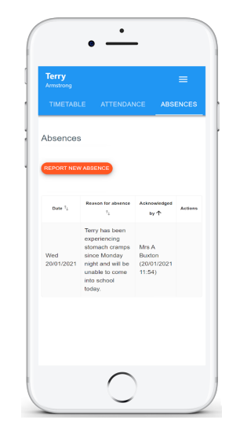
Expectations - Attendance
If your child is going to be absent please notify us as quickly as possible using your Class Charts sign in.
Selecting the Absences tab will display a list of absences that you have reported, once you have reported them.
This includes when the absence took place, the reason for the absence and who acknowledged your absence report.
To report an absence, click on the Report new absence button.
Notes:
KLI

Slide 24
The importance of tutor time
Tutors will be working closely with their tutees and will be meet regularly during tutor time regarding:
General messages
Careers and Futures Guidance
Academic guidance and Study Skills support
Pastoral support and wider personal development
Tutors should be the first port of call for students and parents and carers for any questions, queries or concerns. Their email addresses are on the following slide
Notes:
PG

Slide 25
Tutor contact
Form tutor | Email address | Form tutor | Email address
Ms Threlfall | Caroline.Threlfall@furzeplatt.net | Dr Wyatt | Marina.Wyatt@furzeplatt.net
Mr Bahra | Gurjeet.Bahra@furzeplatt.net | Mrs Budgett | Alice.Budgett@furzeplatt.net
Mr Green | Thomas.Green@furzeplatt.net | Mrs Hawkins | Lynn.Hawkins@furzeplatt.net
Mrs Byrne | Vinita.Byrne@furzeplatt.net | Mr Jones | Chris.Jones@furzeplatt.net
Mr Forster/Mrs Owen | Sue.Owen@furzeplatt.net Stuart.Forster@furzeplatt.net | Dr Walker/Miss Griffiths | Catherine.Walker@furzeplatt.net Lois.Griffiths@furzeplatt.net
Mrs Jack | Deborah.Jack@furzeplatt.net | Mr Green-Nickel | Fred.Green-Nickel@furzeplatt.net
Notes:
PG

Slide 26
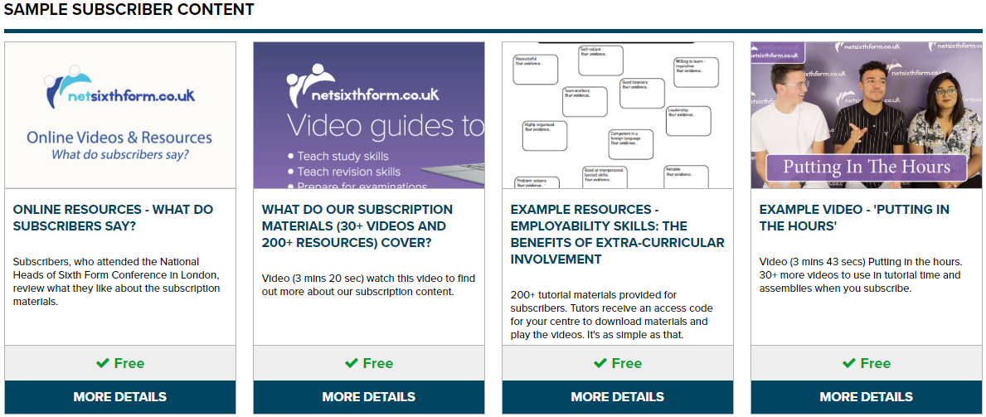
Tutor support/online resources
Tutors will be in touch with students regularly with helpful resources and support tips to help with:
University and apprenticeship application.
Careers guidance
Learning support
Revision assistance
Super curricular information
Notes:
KLI

Slide 27
MOOCs
MOOCs – Massive Open Online Courses
FutureLearn
edx
Coursera
Notes:
PG

Slide 28
How can students best support their academic study?
Download the specifications for all your subjects
Regularly evaluate your learning by using a Personalised Learning Checklist (PLC)
Download exam questions & mark schemes
Read ahead and read beyond your subject
Read and condense your notes – keep this strategy active using the Cornell method distributed last term
Practice answering past exam questions
Research specific topics/areas of study in greater depth using the internet
Manage time well by planning when, where, what and how revision will occur
Notes:
KLI

Slide 29
Independent Study
Students have, on average, 27 hours of lessons per fortnight cycle.
We expect students to match this time commitment with independent study, revision and consolidation.
We give time to students to achieve this in school through:
Supervised Study periods (6 per fortnight)
Independent Study periods (14 per fortnight)
This leaves students around 7 hours per fortnight or 3.5 hours of work to complete at home/in their own time each week.
If students manage their time and use their school time effectively for study, they will protect their work-life balance comfortably.
Notes:
PG

Slide 30
Expectations – Communication
Mobile phones are important tools for learning. Students have access to the school Wi-Fi so they do not have to use their data
A large part of communication will happen via email particularly this year. Students have been instructed to set their emails up on your phones and check their emails every day.
Mobiles phones are only to be used within the walls of the Sixth Form centre, they are not to be visible anywhere outside of the Sixth Form. Should they be seen by a member of staff, they will be confiscated and held at main reception until the end of the day.
Persistent mobile phone breaches will involve parents being required to come and collect the phone on behalf of the student.
Notes:
KLI

Slide 31
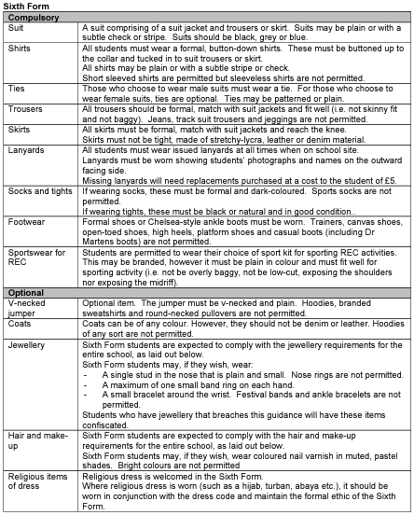
Expectations – uniform
We aim to set high standards in all we do, including how our students are presented.
Our Sixth Form’s uniform is included in the school’s uniform policy, which is on our website (‘Our School, Policies, Uniform Policy’).
Students who do not adhere to the uniform policy may be sent home to change.
Notes:
PG

Slide 32
Making the leap – GCSE to post-16
How we help…
Notes:
KLI

Slide 33
A shared understanding of what is hard
Notes:
KLI

Slide 34
Life is about learning from setbacks – for everyone!
Notes:
PG

Slide 35
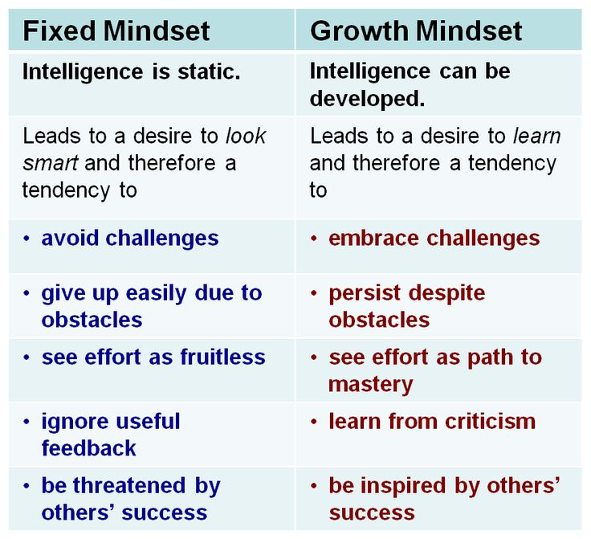
Growth mindsets
Angela Duckworth delivers an excellent TED talk on ‘Grit’ and the Growth Mindset, which you can find here
This is a great example of the sort of material we recommend to students to help them make the transition in Sixth Form
Notes:
KLI

Slide 36
All of this is designed to help students move from…
Dependant
Responsible
Rely heavily on the teacher
Do not know their own strengths and weaknesses
Think that the teacher is responsible for their leaning
Do not set learning goals or reflect on how well they are learning or why? (known as metacognition – really important in the Sixth Form).
Is aware of their own strengths and weaknesses
Is motivated by making progress in learning
Often reflects on the learning process and their own progress
Plans their learning and sets goals
Actively seeks out new learning independently
Notes:
PG
Getting students to see the need to shift from dependent to responsible. Not an instantaneous process but one that needs practice.

Slide 37
Making the leap – GCSE to post-16
How parents can help…
Notes:
PG
Things that you may find useful

Slide 38
How can you help your child
and prepare them to perform?
Being a role model
Help them set goals
Keep them active
Healthy eating
Time out
Sleep patterns
Unplugging
Staying cool & calm
Belief
Be supportive
Each day you can support your child to make choices which can impact how they perform during the next two years
Notes:
PG + KLI
Focus on points 2, 5, 6, 7, 9

Slide 39
Some final bits and pieces…
Notes:
PG
Things that you may find useful

Slide 40
Measuring Progress & Pre-Public Exams (PPE)
Summer work should now be completed and handed in – really useful indicator of starting point.
Effort grades at the end of October.
5 Achievement & Effort grade Reports –
Oct (A2L only) / Dec / Jan / March / Jul.
PPE Week – W/C 26th June 2023
Notes:
PG

Slide 41
Access Arrangements – what are they?
Exam Access Arrangements (EAAs) are the reasonable adjustments that can be made for an exam candidate, and might include things like extra time to complete an exam paper, permission to use assistive technology, or provision of rest breaks.
Notes:
KLI

Slide 42
How are access arrangements determined for Sixth Form?
If your child has been at Furze Platt since Year 9 they will already have been screened and assessed for Access Arrangements
If they had arrangements for GCSE it is likely these will have expired. Students do not need to be tested again BUT we do need evidence from their Year 12 teachers to confirm that the arrangement is still needed. If it is we will reapply to JCQ and the arrangements will be extended to cover A level exams
If your child has come from another school with arrangements the procedure is as above
If your child has come from another school without arrangements they will be screened for access arrangements and taken forward for further testing to determine their needs
Notes:
PG

Slide 43
The process at Furze Platt
Students are screened using a computer programme - Lucid Exact
Results from this screening indicate which students need to go forward for further testing
The teachers are contacted and asked to provide evidence to support access arrangements
Students are tested by our external assessor
When we have
Test results
Teacher evidence
Evidence that the arrangement is the student’s ‘normal way of working’
We apply to the exam boards for confirmation of arrangements.
Parents are notified of the arrangements by letter
Students are monitored for use of their arrangements. If they fail to use their arrangements it is not ‘normal way of working’ and arrangements will be removed. Parents and the student will be consulted before this is done
Notes:
PG

Slide 44
Possible arrangements
Reader
Scribe (laptop with spellcheck)
Laptop
Extra time
Rest breaks
Prompt
If you have any questions, please contact our examinations team at: exams@furzeplatt.net
Notes:
KLI

Slide 45
The 16-19 Bursary
The 16 to 19 Bursary Fund is a government provided, means-tested fund, providing financial support to help students to overcome specific barriers to participation so they can remain in education and training.
There are two types of Bursary details of which can be found under the Bursary section of the Sixth Form handbook on our website: FPSS Sixth Form Handbook
Notes:
PG

Slide 46
Work experience
Students are expected to complete a week of work experience.
W/C 10th July 2023
Further information will be available on this later in the year.
Students can start researching now and reach out to companies.
Tutors are more than happy to check emails of enquiry.
Notes:
KLI

Slide 47
Student Leadership at Furze Platt
We value student leadership very highly at Furze Platt.
House Captain and Ambassador roles and applications for these are coming up and these are great ways to show commitment to the school community.
Other leadership opportunities are often available and should students have any thoughts of something they would like to see at FPSS, they should communicate these with Miss Inwood or myself.
Notes:
PG

Slide 48
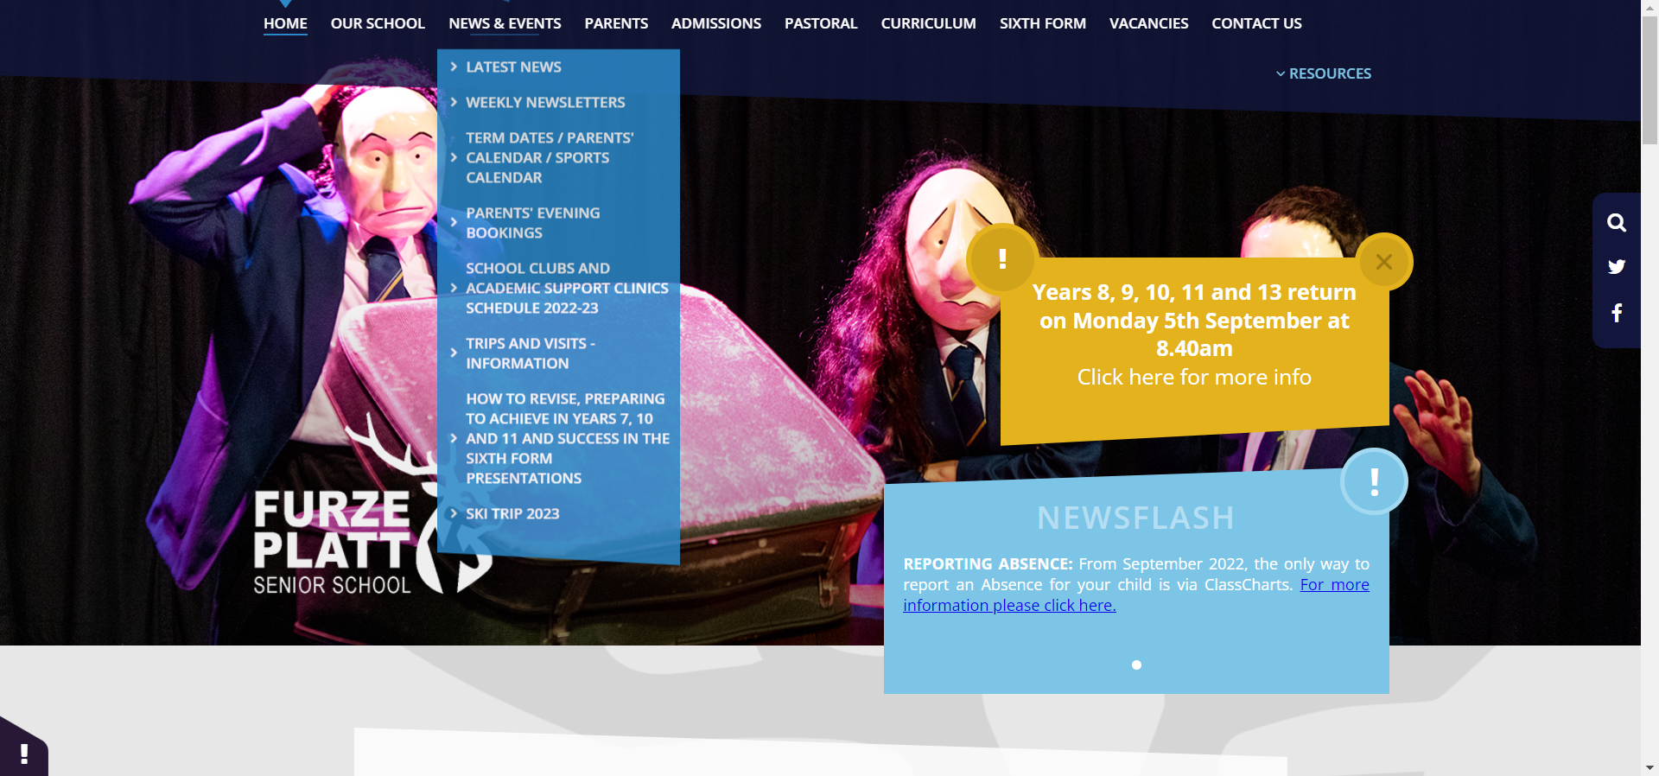
Useful Information
Course guides, student hand book, UCAS & higher education, Key dates, the charter, tutor time
Notes:
PG

Slide 49
Parental clinics
Miss Inwood and I will be available to meet with parents each Wednesday afternoon between 3.30pm and 4.30pm
We will be offering 10-minute appointments over the first half term for parents to drop in and ask any questions they may have
If you would like an appointment time, please email sixthform.admin@furzeplatt.net and we will respond with a 10 minute time slot for a Wednesday afternoon
Notes:
PG

Slide 50
Thank you for listening!
Thank you for reading and listening to this Success in the Sixth Form presentation
We hope this has been informative for you
Should you have any further questions, do contact your child’s form tutor and they will be only too happy to help
All that remains is for us to say how much we are looking forward to supporting your child through their post-16 journey and that we look forward to working with you over the next two years!
Notes:
PG

